Slide 1
Origins of Data, Computing
Lines, Curves, and Numbers
Dr. Charles R. Severance
www.ca4e.com
online.dr-chuck.com

Slide 2
Outline
Solar System
  Stonehenge / Sun Dial
Continuous physical analog computing
  Ankithera / Planet Mobile / Slide Rule / Pilot E6B
Digital physical devices
  Pen / Clocks / Adders / Multipliers
CRC Standard Mathematical Tables
  More complex mathematical functions without calculator
Iteration
  "Human Computers" / Babbage Difference Engine
Electromechanical Computers
  Bombe / Pinball Machine
Electronic Computers – Tubes
  Colossus

Slide 3
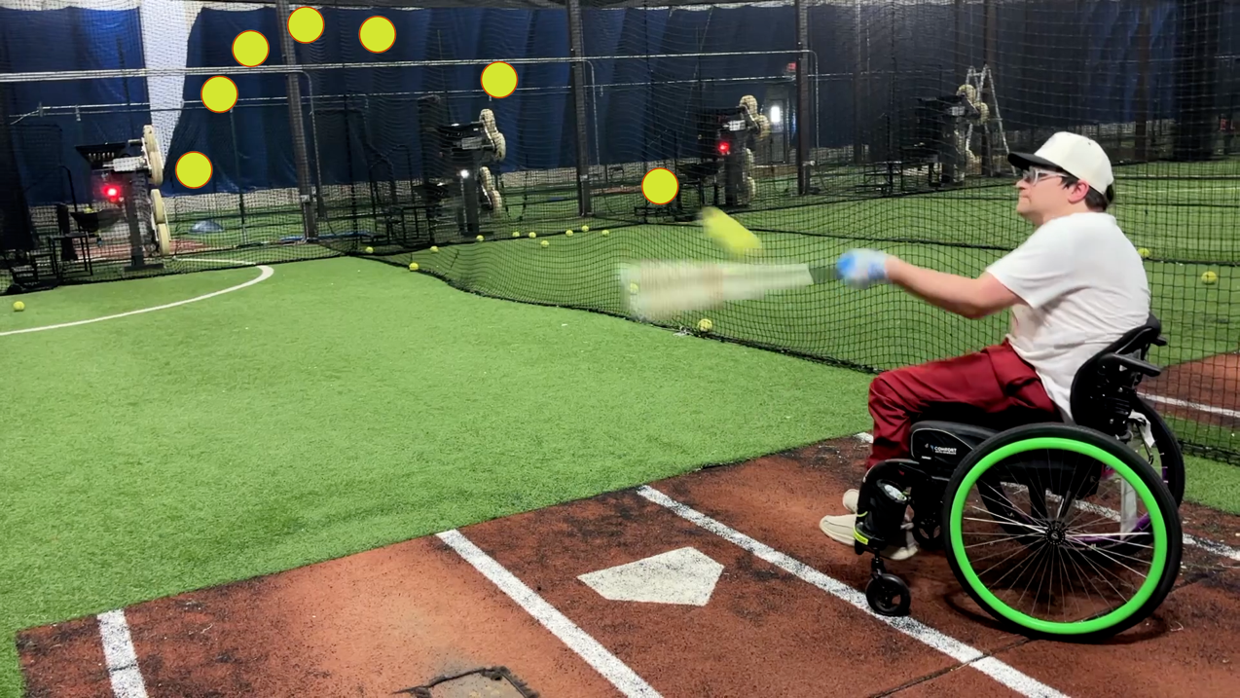
Our eyes "see" objects in a straight line from our eye to the object. But in nature, any moving object is moving along a curve. Predicting the path of a moving object requires a lot of measuring, analysis, and mathematics. Our brains understand (or have been programmed to understand) curved motion implicitly. Predicting the path of a moving object in three dimensions is necessary for us to survive (or play sports)
Photo Courtesy of @WarWheelz

Slide 4
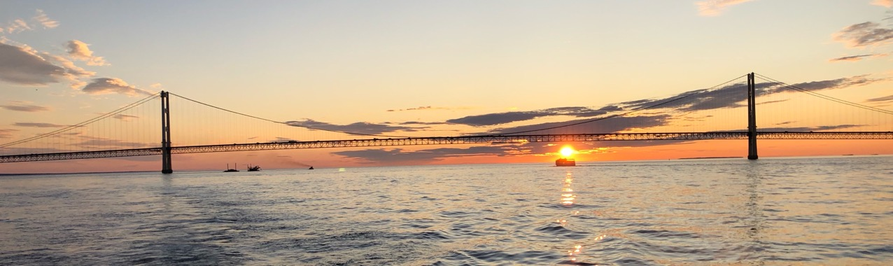
Astronomy – Star Gazing
Amateur scientists from the beginning of human consciousness have stared at the Sun, Moon, Planets, and Stars and tried to gain insight
December
March
June
August
December
September
June

Slide 5
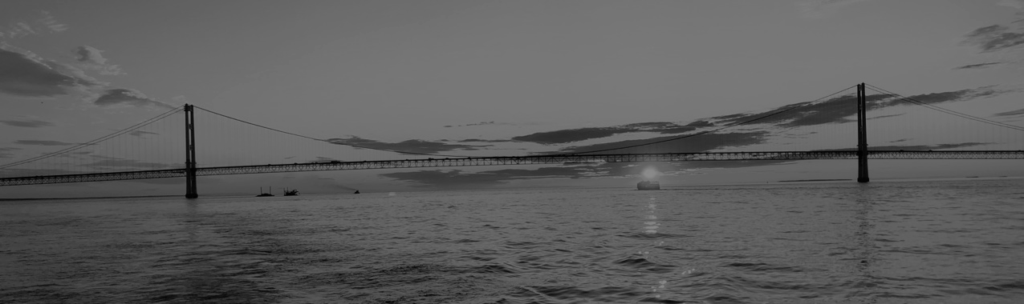
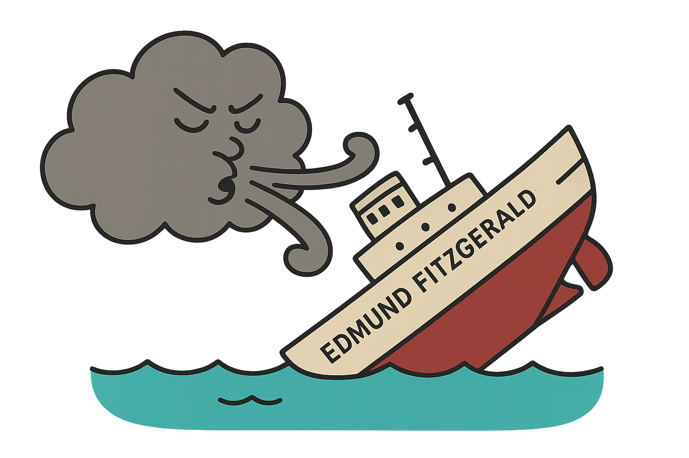
Astronomy – Star Gazing
Amateur scientists from the beginning of human consciousness have stared at the Sun, Moon, Planets, and Stars and tried to gain insight
December
March
June
November
December
September
June

Slide 6
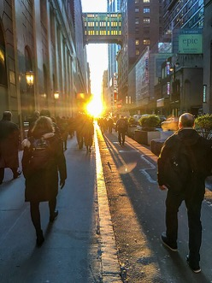
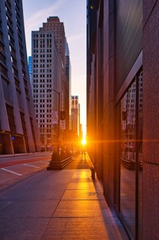
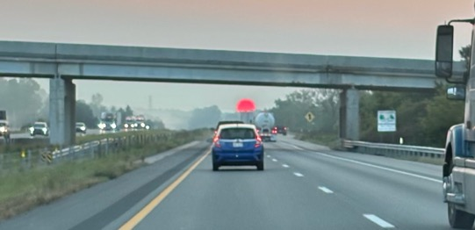
Stone Henge – 4500 Years Ago (YA)
AI: Ancient artifacts to measure the Sun around the world
  Gobekli Tepe, Turkey Lunar / Solar Calendar (?) – 13000YA
  Egypt Sun dials invented 3500 years ago (YA)
  China sun dials over 3000 YA
  Mexico The Descent of Kukulkán – 1200 YA
  Temple of Petra 1000 YA
  India Sun Temple, Konârak – 750 YA
Modern Henges
  Manhattan Henge 2020-01
  Chicago henge 2022-03
  Dr. Chuck's commute henge 2024-09
Photos from Wikipedia.

Slide 7
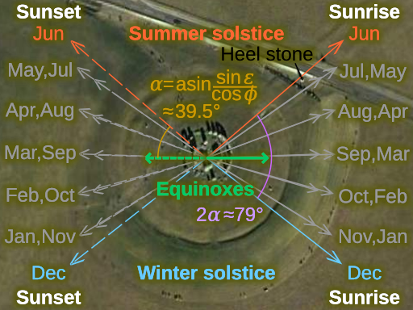
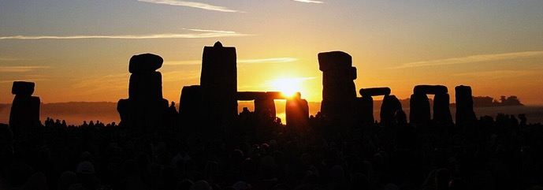
Stonehenge: Sunrise and sunset tracking
Stonehenge had several versions and was built iteratively from 5100 YA to 3600 YA (Years ago)
By the time the center structure was built, the earlier structures carefully measured the angle of sunrise and sunset throughout the year
You can think of it as a sun tracking data table calibrated over 2500 years

Slide 8
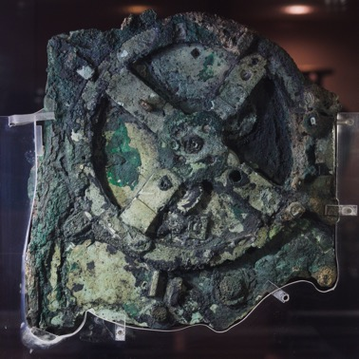

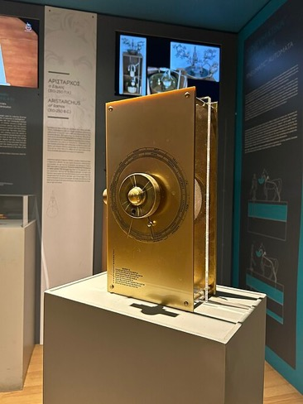
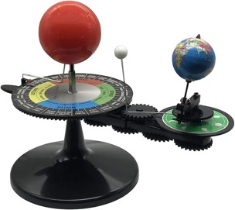
Antikythera mechanism – 2100 YA
Oldest known continuous analogue computer
Uses gears to model the known solar system
  Sun, Moon, Earth, Mercury, Venus, Mars, Jupiter, Saturn
  Models more complex Sun-Moon-Earth 19, 76 and 223 year cycles
Indiana Jones and The Dial of Destiny
You can buy one on Amazon
AI: Antikythera like mechanisms in cultures around the world

Slide 9
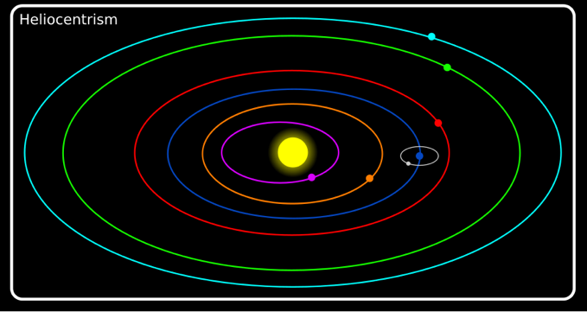
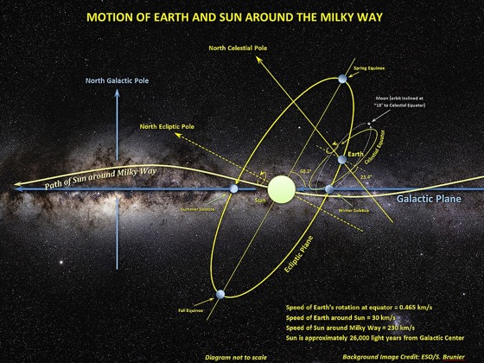
Reflections on Solar System Models
www.ca4e.com/ref
We have been taught a simple model of the solar system called "helio-centrism" conceived by Nicolaus Copernicus in 1543
But the planets are at different angles and the sun is also moving
Earth moves in a spinning moving vortex chasing the sun through the Milky Way
AI: Actual motion of earth through the milky way galaxy
AI: Nicolaus Copernicus gets in trouble
Notes:
www.youtube.com/watch?v=fJuaPyQFrYk

Slide 10
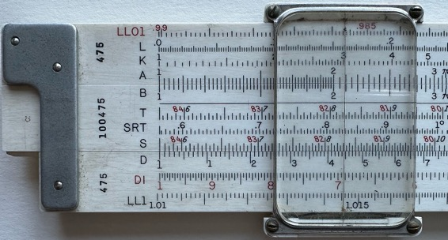
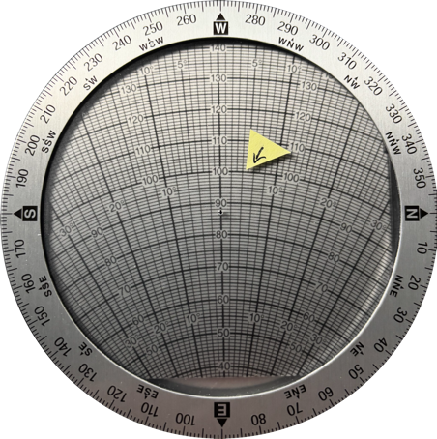
Modern Continuous Analog Computing Devices
Slide Rule – Multiplication using addition and logarithms
E6B wind calculator for airplane pilots that uses a circular calculator to do trigonometry and Pythagorean theorem computations
https://commons.wikimedia.org/wiki/File:Slide_rule_scales_front.jpg

Slide 11
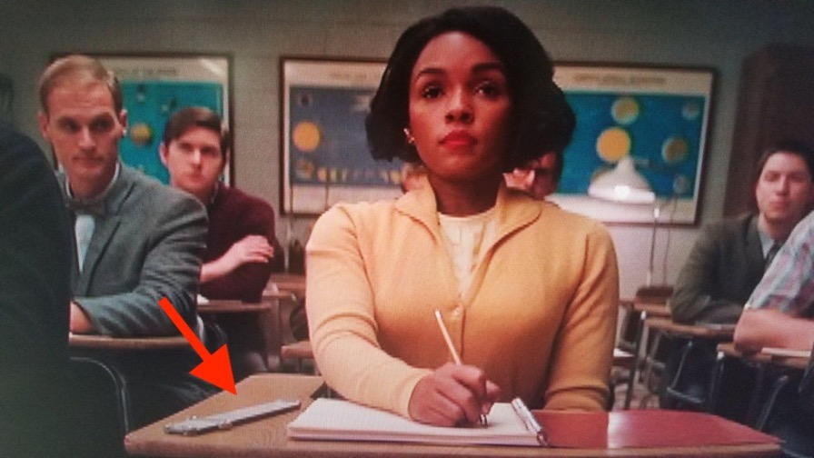

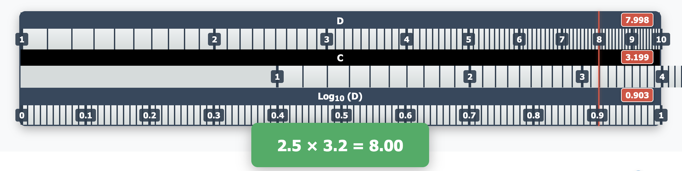
Slide Rule
www.ca4e.com/ref
Screen shot from Hidden Figures movie
https://commons.wikimedia.org/wiki/File:Slide_rule_scales_front.jpg

Slide 12
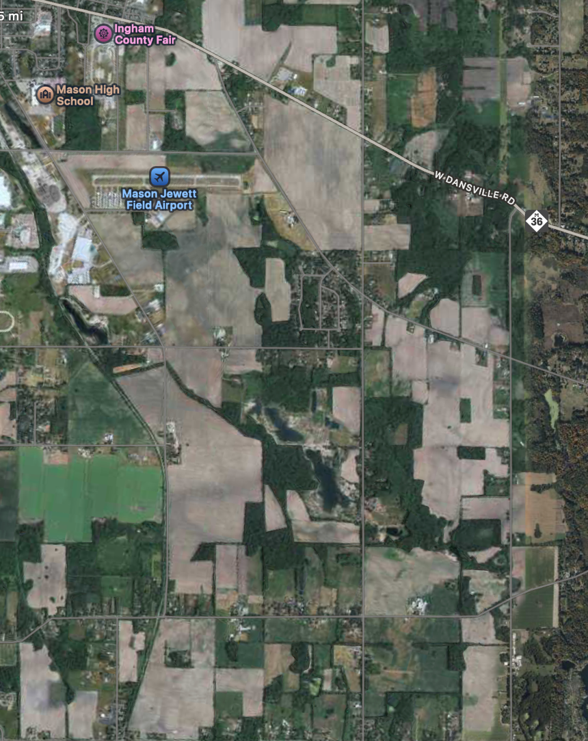
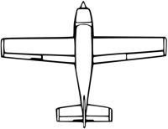
Computing Wind Correction for Airplanes (drift angle)
Our airplane goes 100 miles per hour and we want to go west (270 degrees)
The wind is out of the northwest (300 degrees) at 15 miles per hour
If we fly straight west, the wind will both slow us down and push us south
Where should we point the plane to actually go west and what is our effective ground speed?

Slide 13
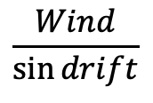

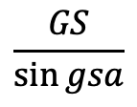
Use Law of Sines!
wa
WIND
www.ca4e.com/ref
WIND
WIND
gsa
wa
gsa
gsa
wa
GS
GS
TAS
GS
TAS
TAS
$$\frac{TAS}{\sin{wa}}$$
=
$$\frac{Wind}{\sin{drift}}$$
=
$$\frac{GS}{\sin{gsa}}$$
drift
drift
drift
# Python:
drift = math.degrees(math.asin(math.sin(math.radians(wa)) / tas * wind))
gsa = 180 - ((wa % 180) + drift)
gs = math.fabs((wind * math.sin(math.radians(gsa))) / math.sin(math.radians(drift)))

Slide 14
To *actually* go west…
Our airplane goes 100 miles per hour and we want to go west (270 degrees)
The wind is out of the northwest (300 degrees) at 15 miles per hour
We will fly a heading of 274.3 degrees and expect a ground speed (west) of 87 miles per hour

Slide 15
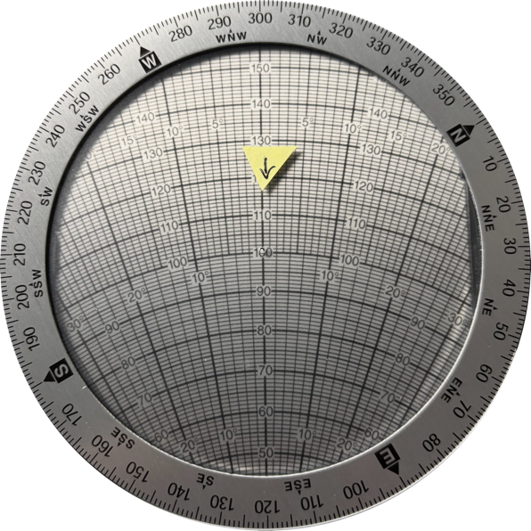

Pilots and Trigonometry?
Set Wind Direction
Set Wind Speed
We have an analog computer called the E6B that does the entire calculation by rotating and sliding and reading numbers directly from the device
This is an analogue equivalent to the trigonometric computation
Rotate to true course
Slide to air speed
Read drift angle
Read ground speed

Slide 16
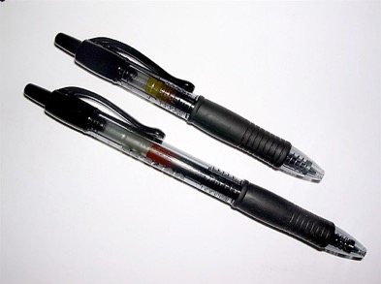
Physical devices that are digital
Physically built to have two stable states
  On (1) or Off (0)
Require sufficient physical input to switch states – you often hear a click
If the input is not enough to change state they usually fall back to the previous stable state
Capturing the new state is often called "latching" – it sounds a bit like clicking
https://en.wikipedia.org/wiki/Retractable_pen

Slide 17
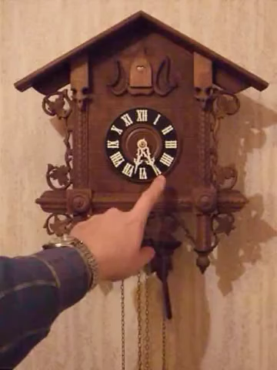
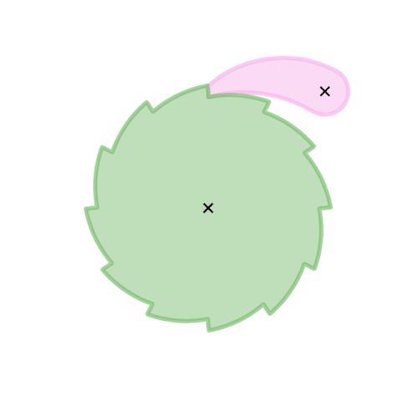
Clocks as Counters
Early clocks used a pendulum and a series of ratchets and gears that acted as counters for seconds, minutes, and hours
At particular times / counts they would run "programs" to make sounds to mark the passage of time
https://en.wikipedia.org/wiki/Ratchet_(device)
https://en.wikipedia.org/wiki/Cuckoo_clock

Slide 18
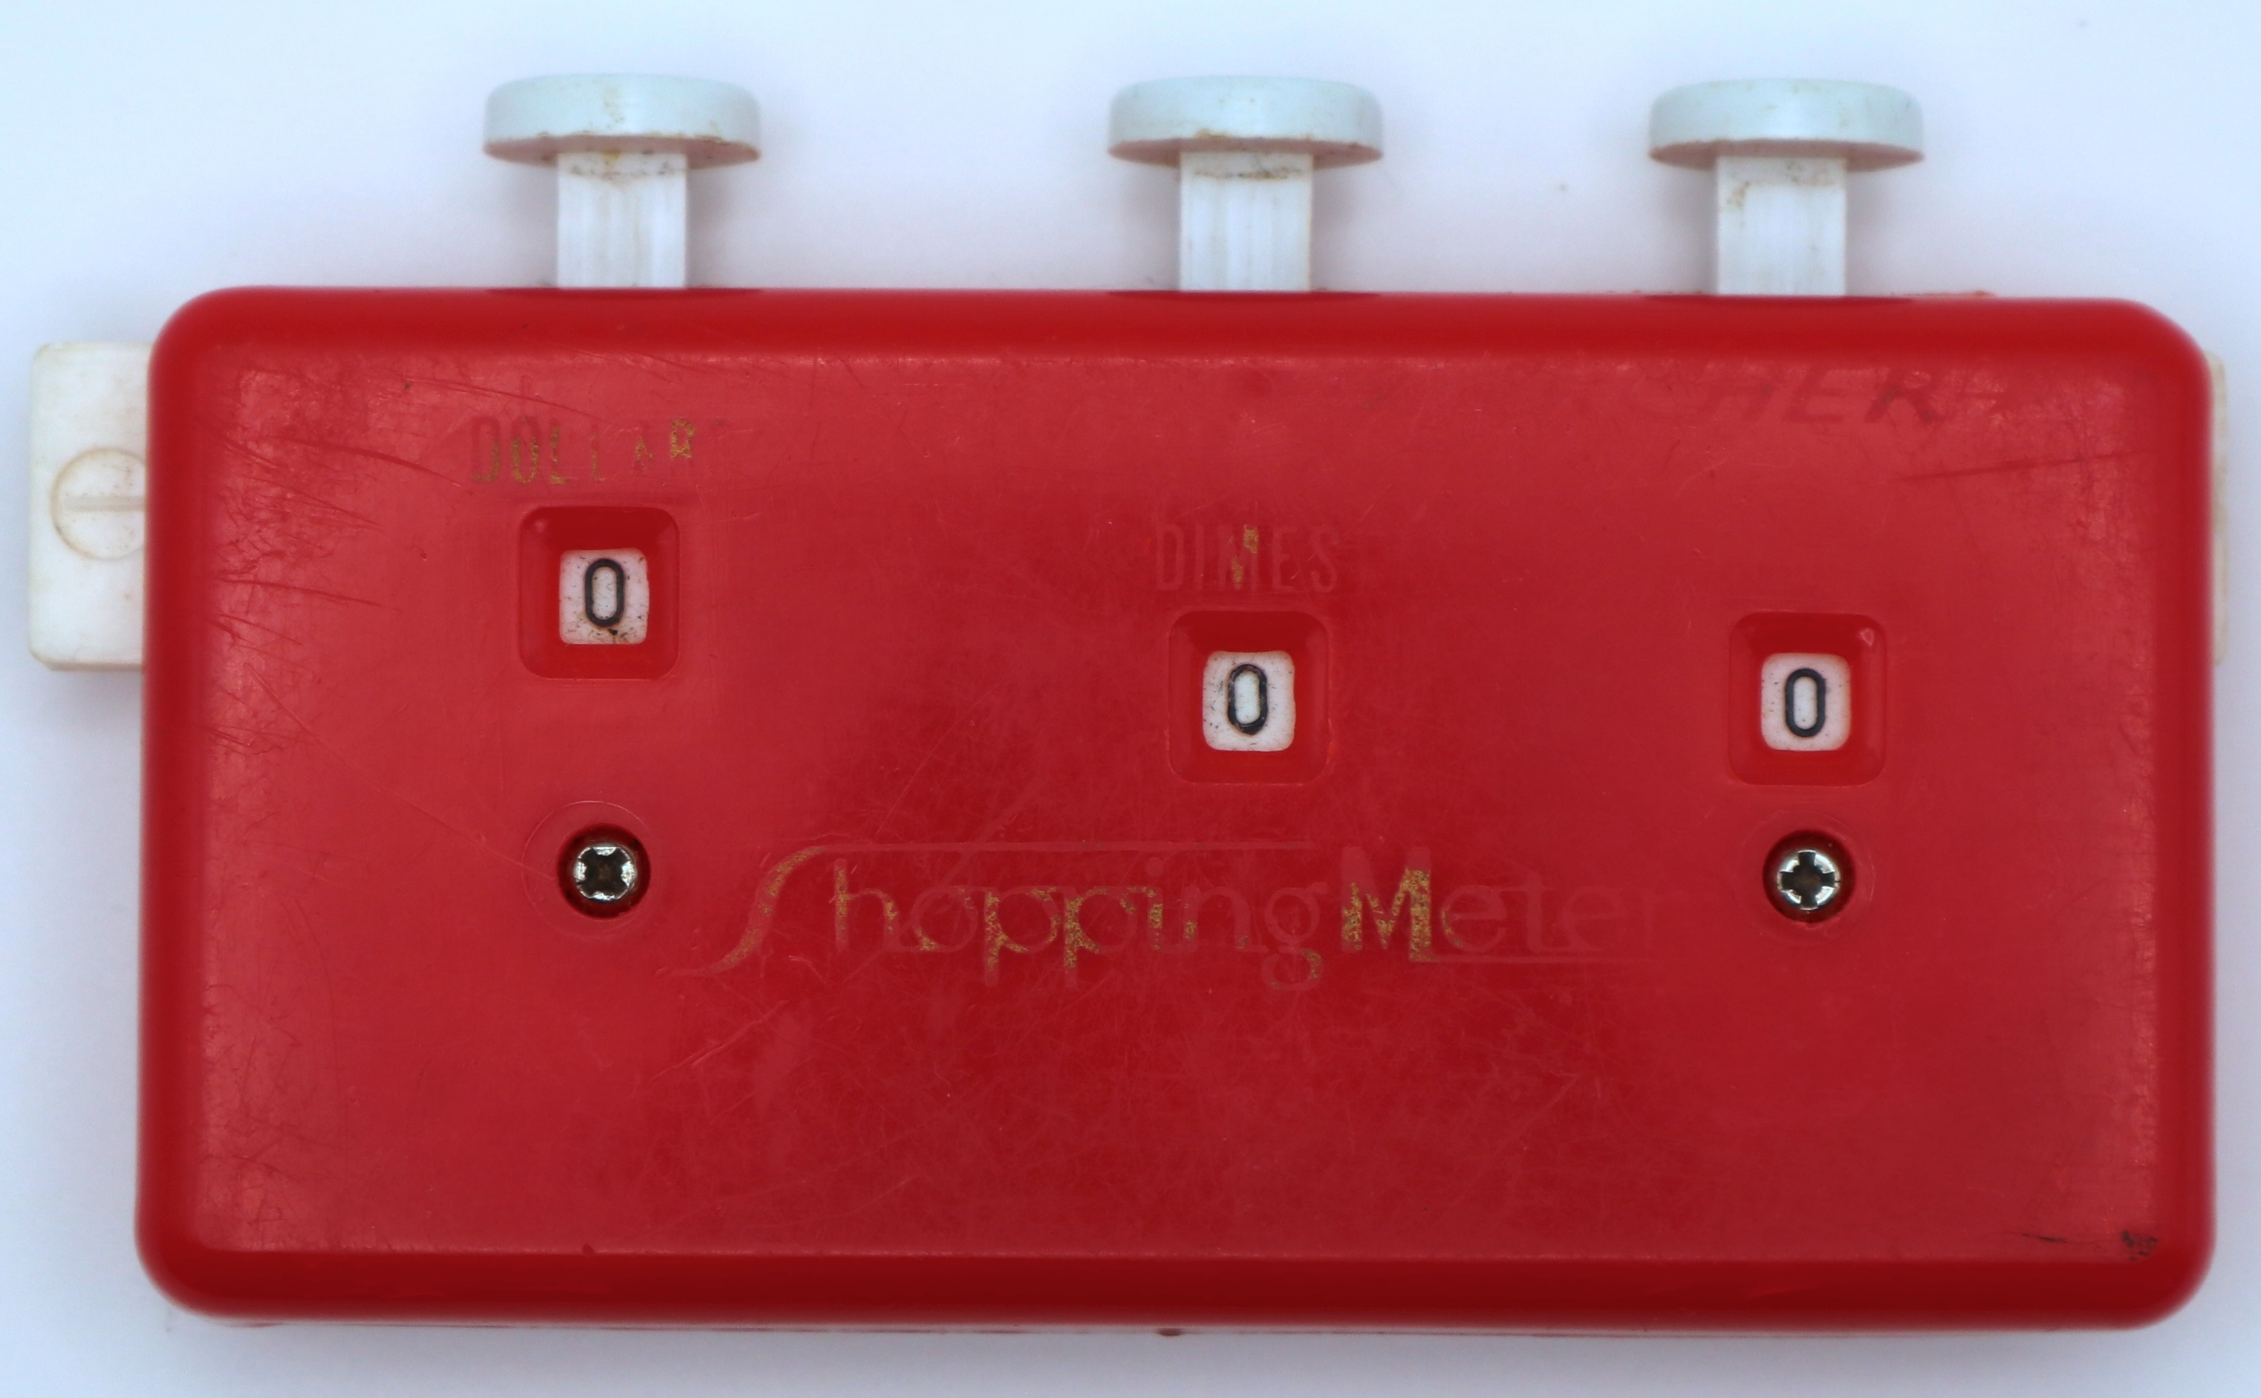
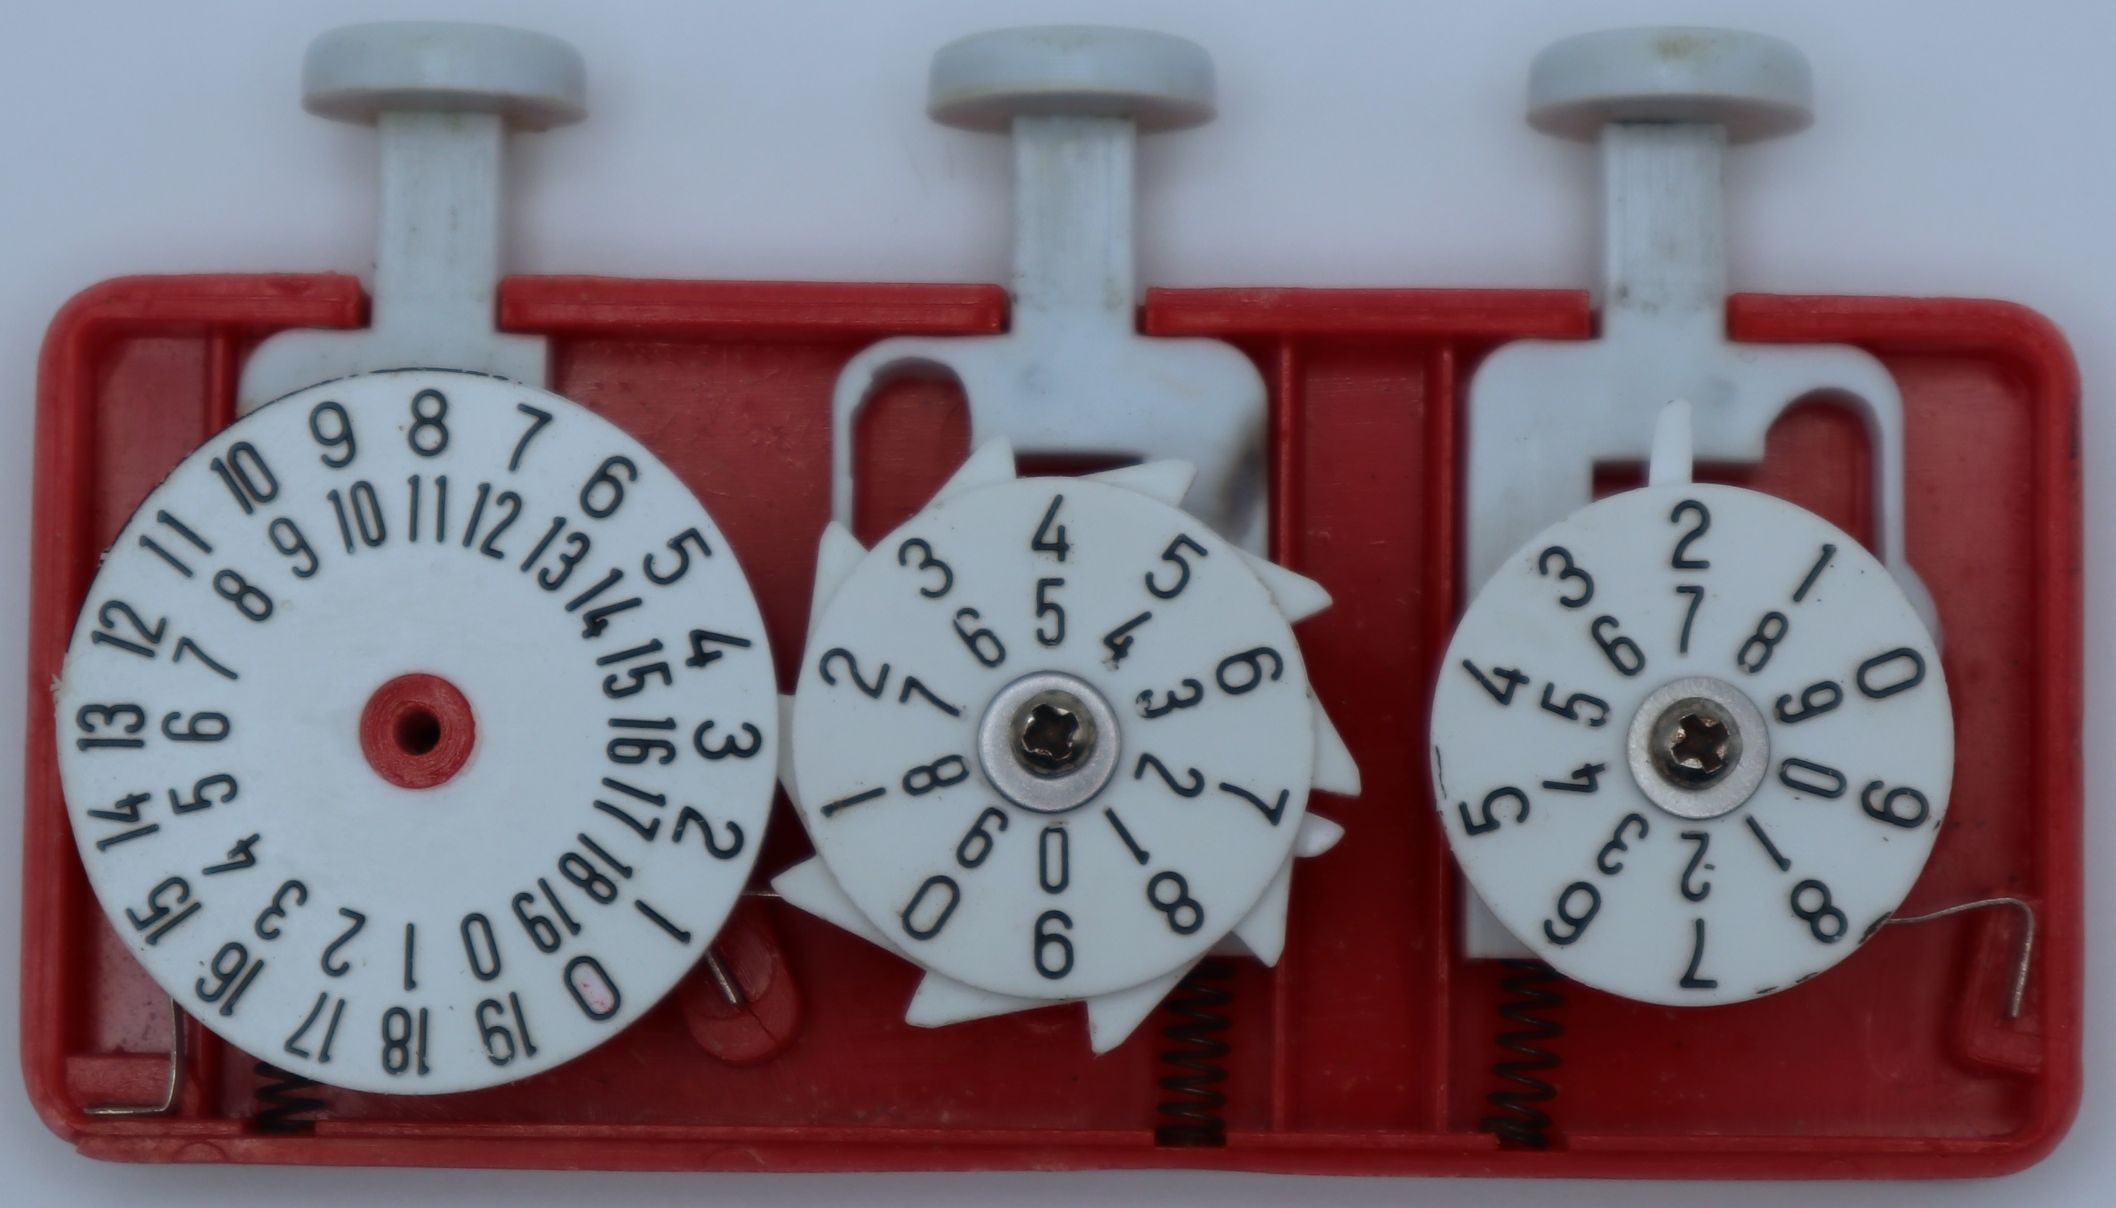
Counters with Carry Propagation
Numbers with multiple columns can be added if there is a carry mechanism that advances the next column when the current column overflows
Note that carrying into a column can cause overflow into the next column – so we call this "ripple carry" as it has the potential to ripple through several columns.

Slide 19
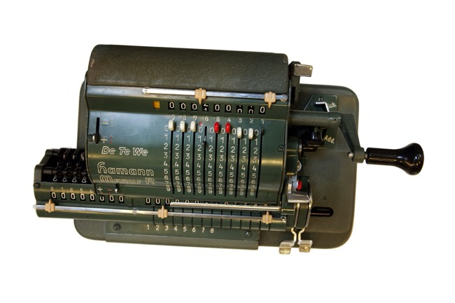
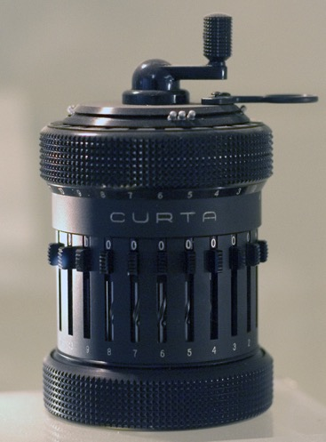
Iteration
With larger numbers and addition with carry as something that can work, the move is to "iterate"
Multiplication is repeated addition. If you have a way to count down from a number, you can add a motor or crank to automate multiplication.
https://en.wikipedia.org/wiki/Mechanical_computer

Slide 20
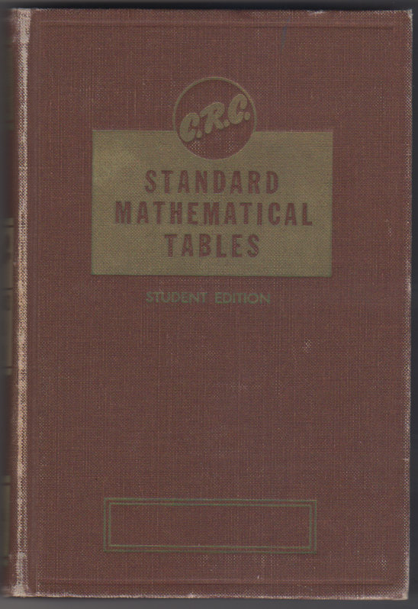
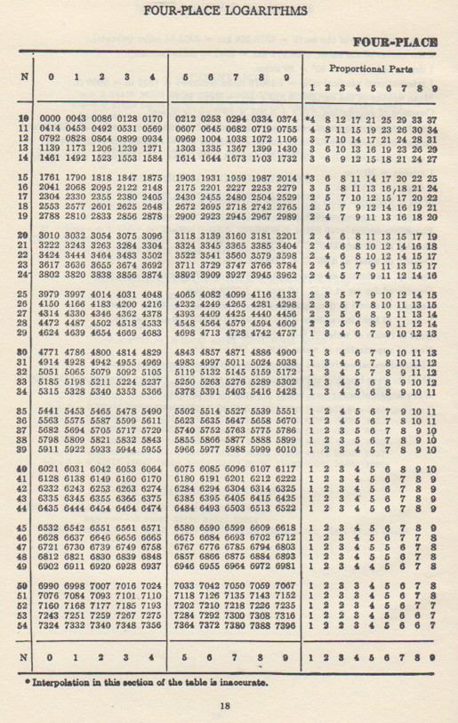
Before Scientific Calculators
For more complex math like trigonometry and logarithms we often used books with tables of numbers.

Slide 21
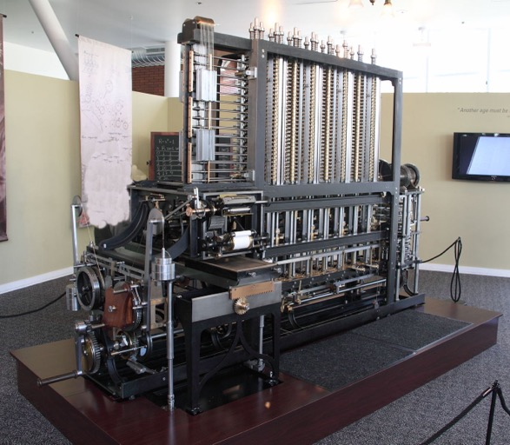
Babbage Difference Engine
www.ca4e.com/ref
In the 1820's Charles Babbage designed a mechanical calculator to compute up to seventh order polynomials
It could produce tables of advanced functions using polynomial approximation
Babbage built a small prototype in the 1800's but a full scale system was not built until 1991 – and it worked!
https://en.wikipedia.org/wiki/Difference_engine

Slide 22
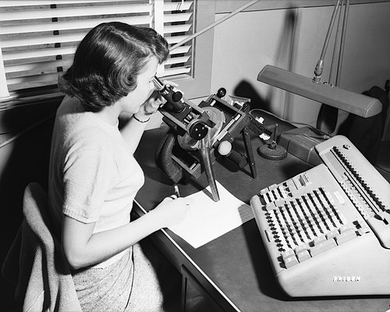

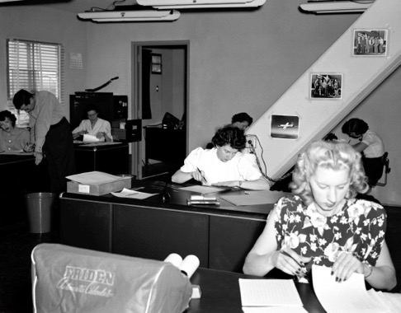
Human Computers
Until the advent of Scientific Calculators (sin, log, etc.) we depended on tables for complex functions
Often these tables were produced using "Computers" – people that used add/multiply machines to run long calculations to produce the tables
The movie "Hidden Figures" (2016) explores the shift from human to electronic computers
https://en.wikipedia.org/wiki/Computer_(occupation)
https://en.wikipedia.org/wiki/Hidden_Figures

Slide 23
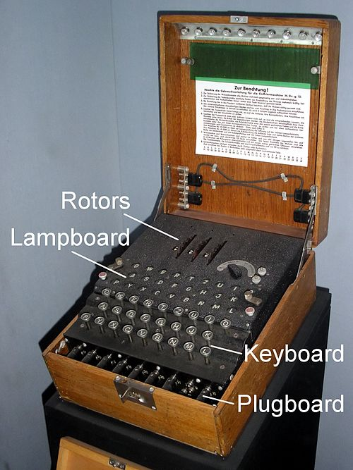
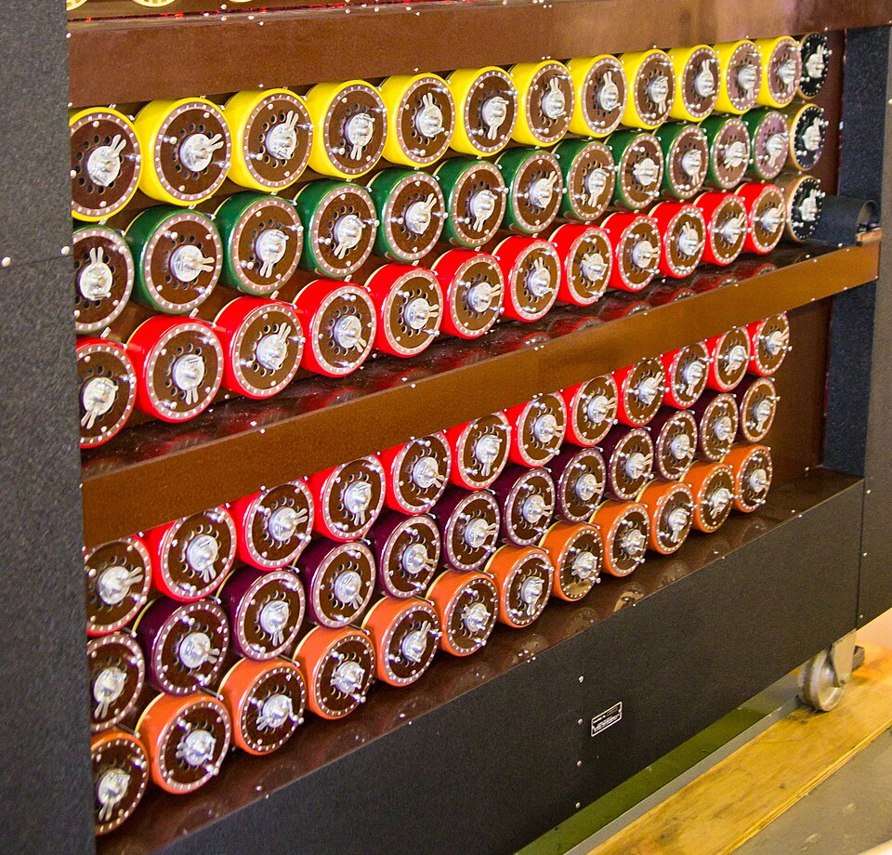
Bombe – Electromechanical Iteration
During World War II, the Germans used a device called "Enigma" to encrypt messages and send them using morse code and radios
The Bombe was a British device that tried repeatedly to guess the Enigma settings for the day (like a "password")
https://en.wikipedia.org/wiki/Bombe

Slide 24
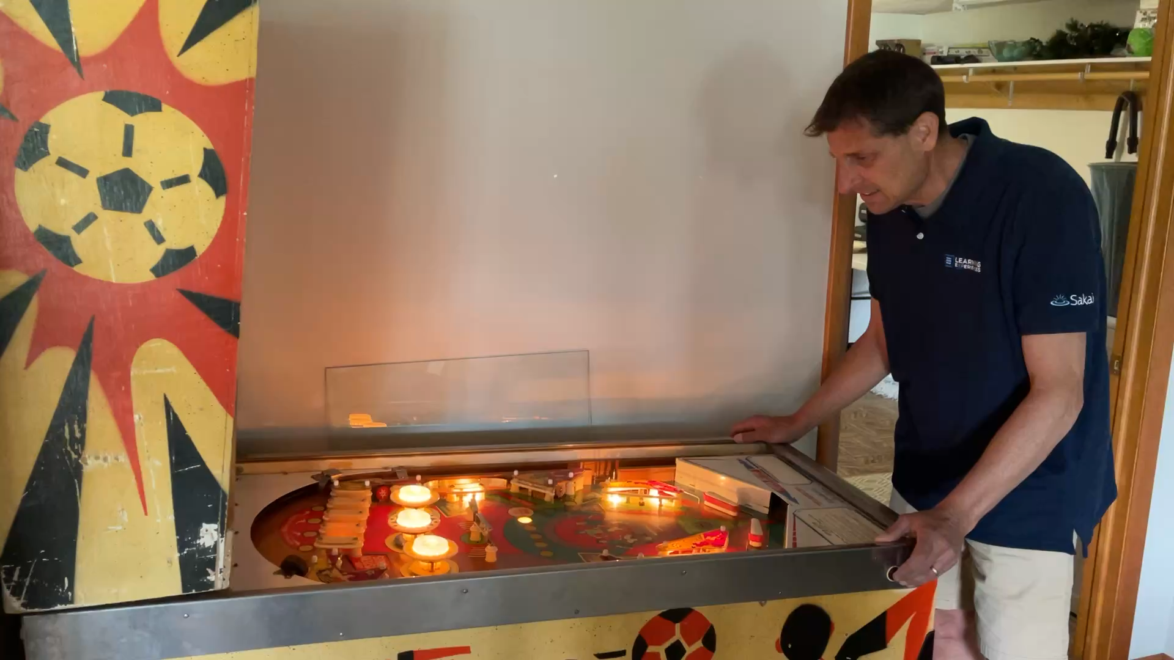
Pinball Machine – Electromechanical
A Pinball machine uses switches, relays, and physical storage to keep track of a game score, award specials, count the number of balls, take money, start and stop games
It requires careful attention to the timing of signals and devices
It is very much like a simple Bombe in terms of the technology used

Slide 25
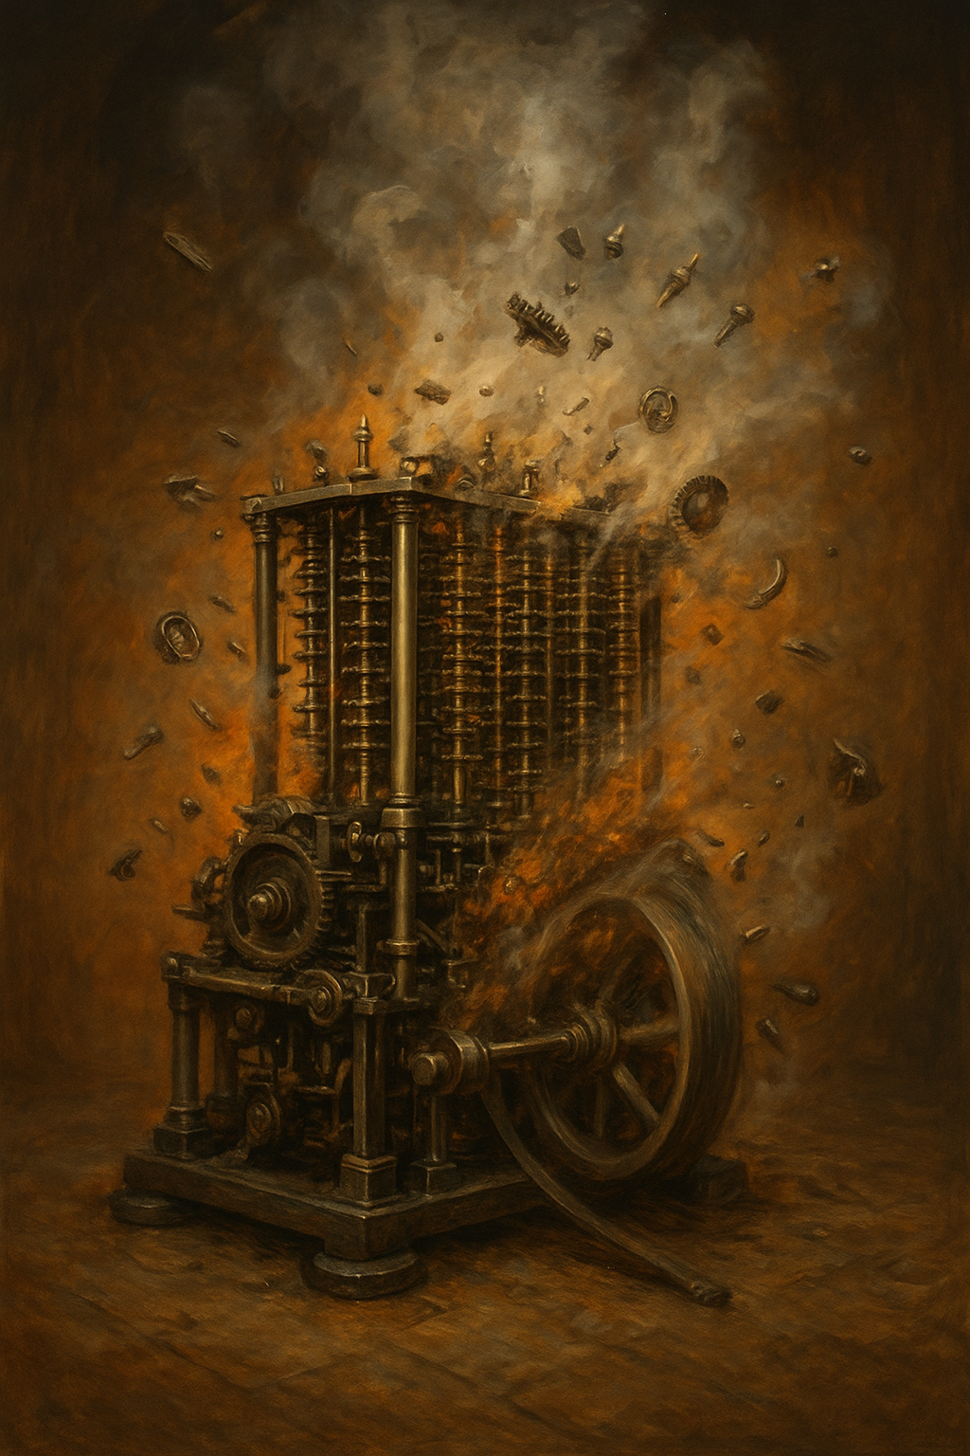
Colossus – Moving toward pure electronic
Up to this point, when there is a numeric value, we are changing like the "current time" or the "total points" we must physically change the value.
  "Latch", "Click", etc..
  This takes time, power, and generates friction / heat / wear
The speed of computation is physically limited so as not to damage the machine
ChatGPT: A Babbage Difference Engine overheating and starting to fall apart because it is running too fast.

Slide 26
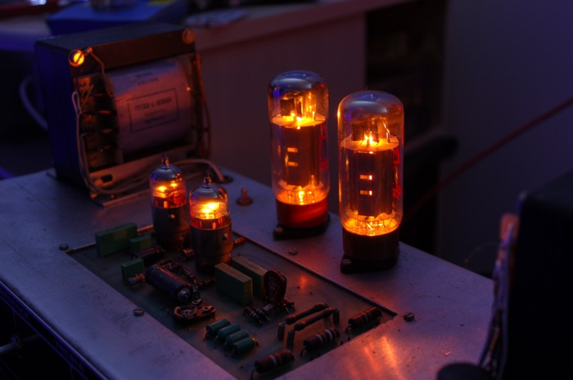
Electronic Switching using Tubes
An electronic "tube" or "valve" takes an input signal and power connection and produces a "louder" / "amplified" version of the signal
Tubes are analog and continuous but with a little more electronics they can be "digital" and latch in and maintain a "zero" or "one" value
Tubes take power and generate heat, but have no moving parts so they can switch faster than physical "latches"
https://en.wikipedia.org/wiki/Vacuum_tube

Slide 27
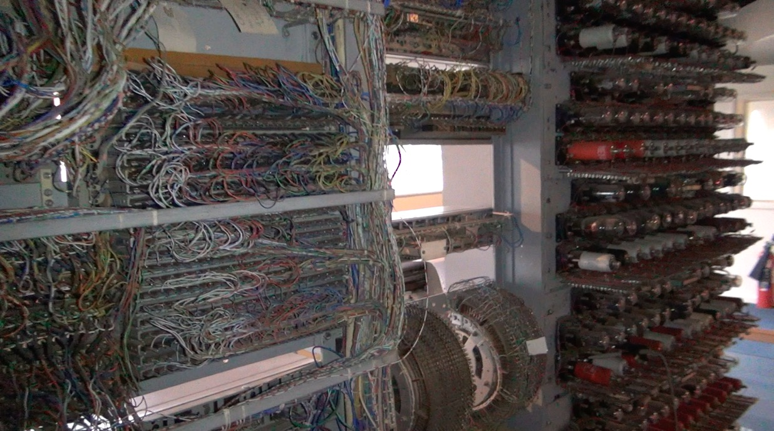
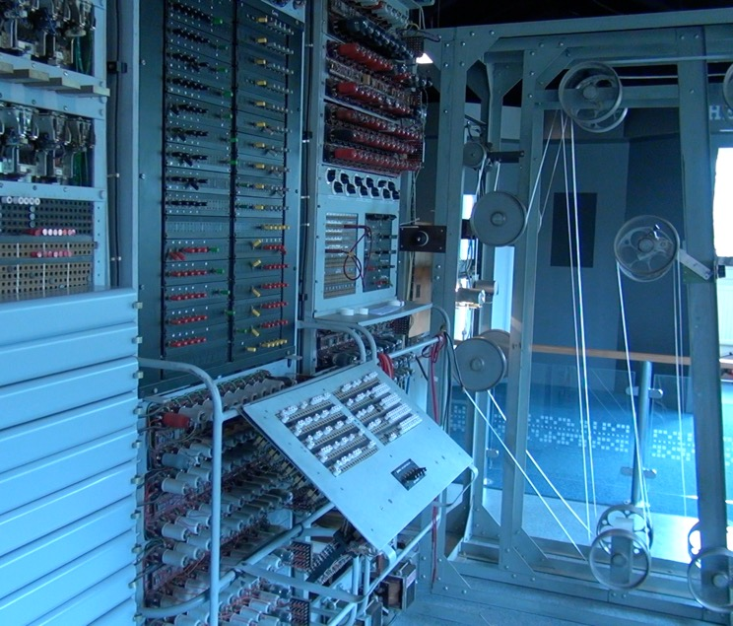
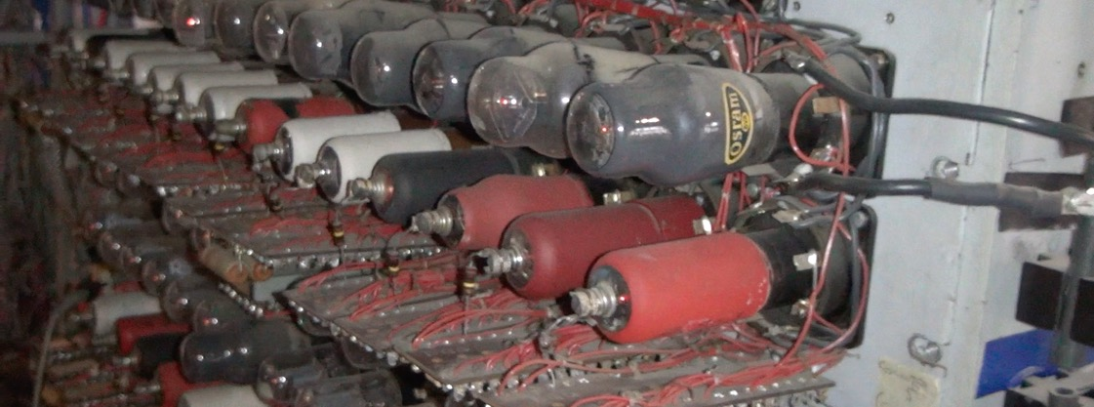
Colossus
By using tubes, Colossus could do addition and other computations much faster than the Bombe.
Power consumption and heat dissipation are still a challenge.

Slide 28
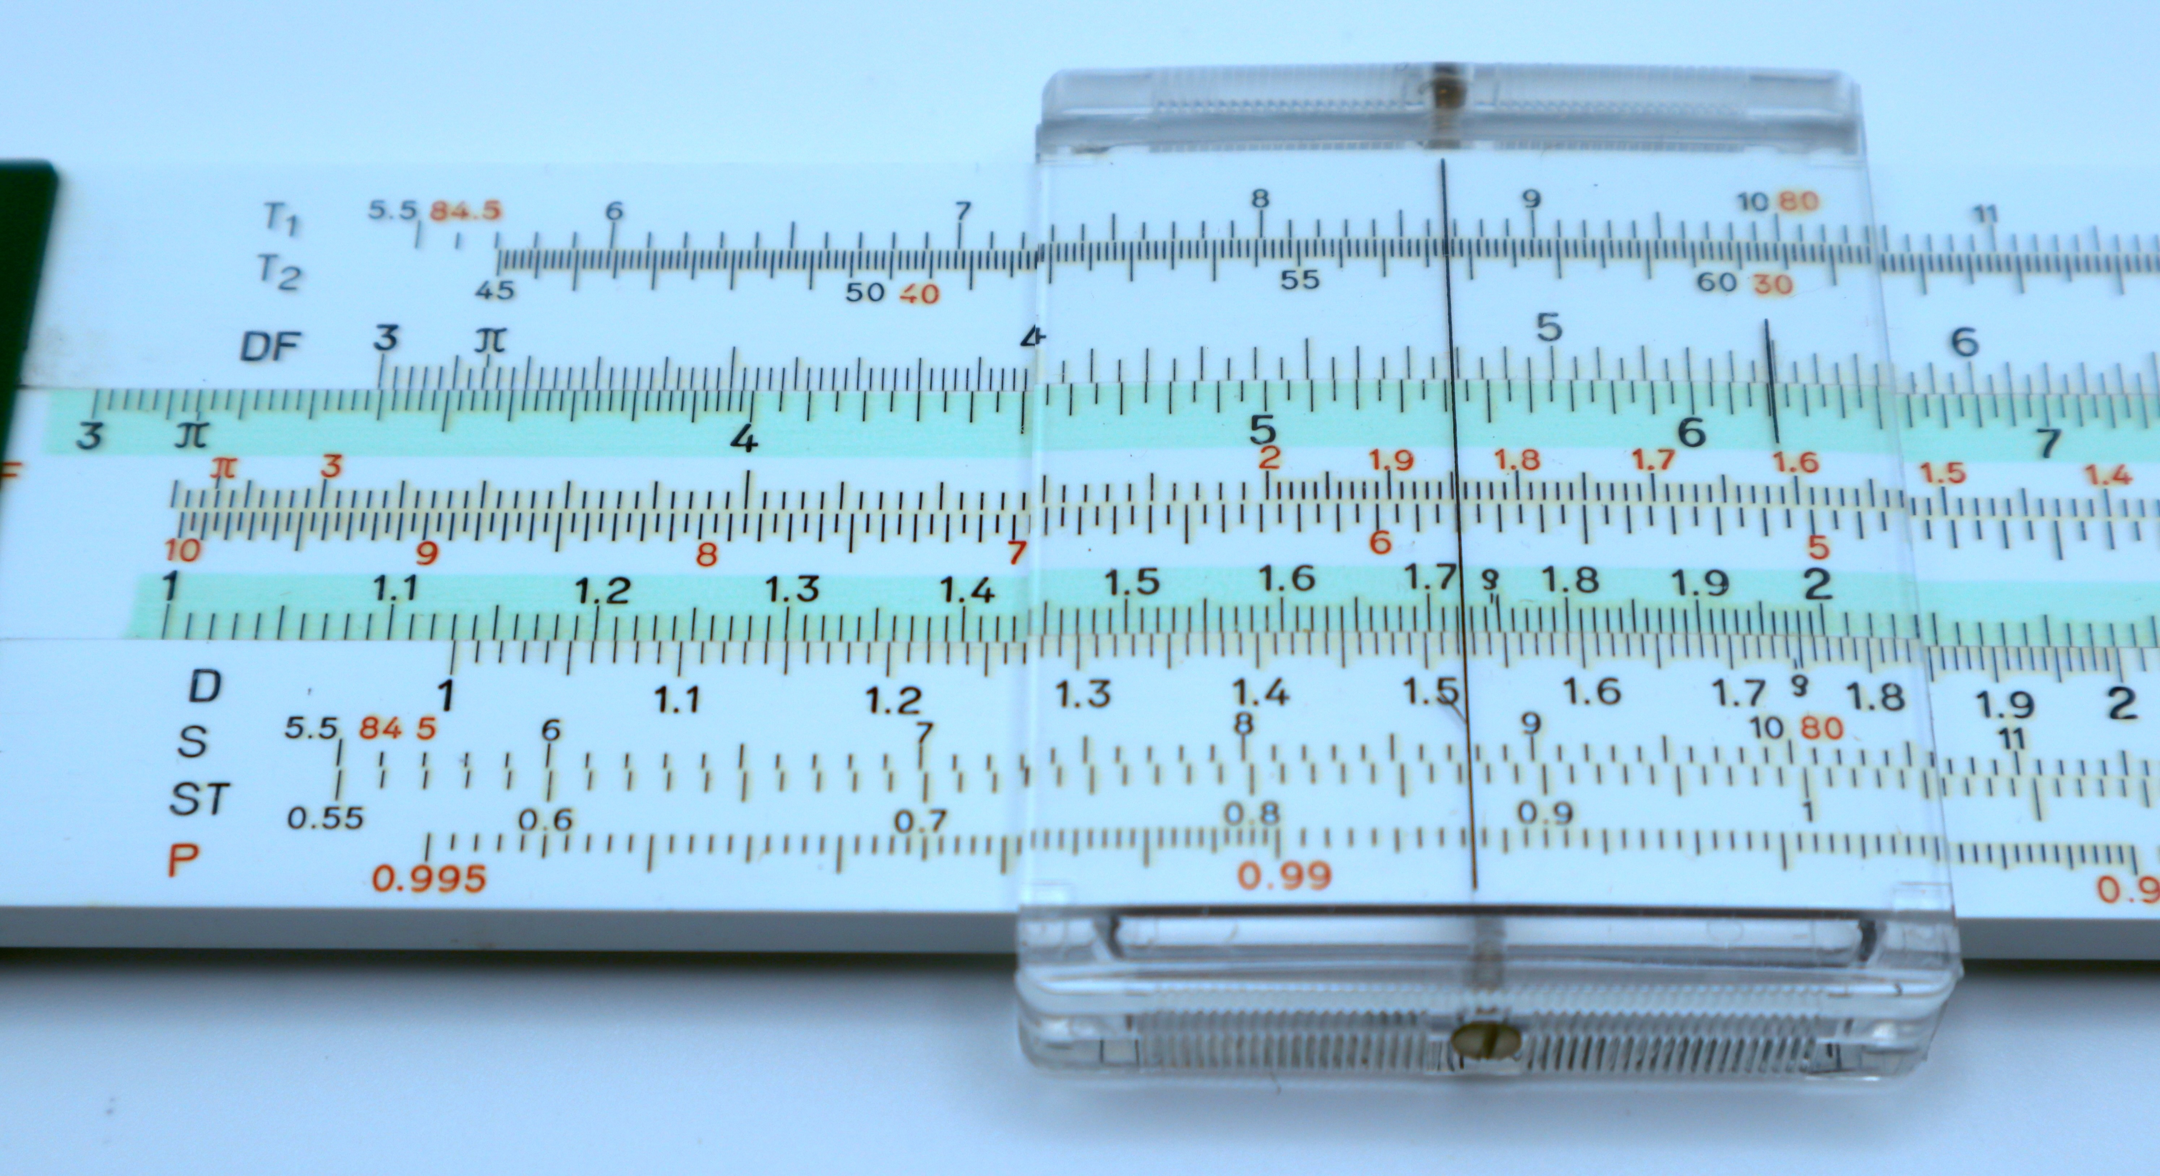
Hidden Figures - Programming
A subplot within the Hidden Figures (2016) movie is the transition from doing complex calculations manually to writing programs using FORTRAN on an IBM 7090
There was a natural parallel between following instructions precisely and precisely defining the instructions that a computer would follow
Being a human computer was a natural training ground for the emerging programming field
SUM = 0
DO 10 I = 1, 10
SUM = SUM + I
10 CONTINUE

Slide 29
Summary
Humans have built endless physical devices over time to help us better understand things like
  Astronomy
  The passage of time
  Navigation through moving mediums (airplane / boat)
  Accounting / money
  Curved motion under the effect of gravity (space craft)
The IBM 7090 in Hidden Figures was built using transistors – solid state electronics that greatly reduced heat and power consumption and increased speed (24,000 multiplications per second)

Slide 30
Acknowledgements / Contributions
These slides are Copyright 2025- Charles R. Severance (online.dr-chuck.com) as part of www.ca4e.com and made available under a Creative Commons Attribution 4.0 License. Please maintain this last slide in all copies of the document to comply with the attribution requirements of the license. If you make a change, feel free to add your name and organization to the list of contributors on this page as you republish the materials.
Initial Development: Charles Severance, University of Michigan School of Information
Insert new Contributors and Translators here including names and dates
Continue new Contributors and Translators here

