Slide 1
The CDC 8512 Microprocessor
Dr. Charles R. Severance
online.dr-chuck.com

Slide 2
Outline
Our two-instruction "CPU" - What is missing?
Instruction decoding and control
Real CPUs
The CDC8512 – inspired by the CDC 6500
Emulators – JavaScript – Old video Games at archive.org
Reading: Evolution of CPU Architecture
Reading: Intel 4004 – Back to the beginning

Slide 3
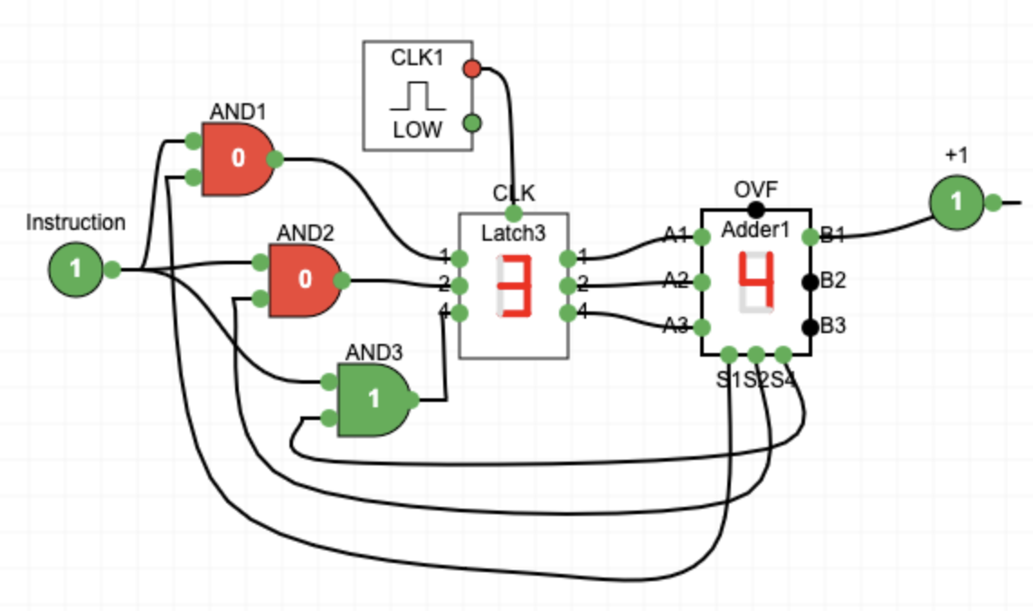
What is missing?
The instructions are not being read from memory.
It is like there is a switch on the front of the computer and it chooses between the two instructions
We want a flexible sequence of many combinations of instruction sequences(a.k.a. Software)

Slide 4

What
Next?
Generic
Computer
Software
Input
and Output
Devices
Central
Processing
Unit
Secondary
Memory
01001001
00111001
Main
Memory
Python for Everybody
Chapter 1
Slide 19
Machine
Language
Notes:
This slide is a block diagram of a computer showing a central processing unit connected to main memory. Software is loaded into the main memory. The software can also interact with input / output devices and secondary memory for long-term storage.

Slide 5
Fetch-Decode-Execute-Cycle
CPU
ALU
Data
Registers
Program Counter (PC) Register – Address of the next machine code instruction
Current Instruction Register (CIR)
The decoder looks at the bits of the CIR and using gates activates the correct ALU Element and register
The Clock causes the logic when to compute and when to copy results back to the register
PC
CIR
Decoder
Instructions
Cache / Memory
https://en.wikipedia.org/wiki/Binary_decoder

Slide 6
Machine Language Instructions
As part of the documentation for a CPU, we are given the bit patterns of the machine code for each of its instructions
There is usually a symbolic language that translates to machine language (assembler)
Assembly Language | Binary | Description
ZERO reg | 01000rrr | Set register to zero
CMPZ reg | 01001rrr | Compare register to zero
INC reg | 01010rrr | Increment register by 1
DEC reg | 01011rrr | Decrement register by 1

Slide 7
Real CPUs

Slide 8
Modern Processor Families
Intel X86 – Introduced in 1978
  Focused on Desktop computers
  Includes AMD
ARM – Introduced in 1985
  Focused on early cell phones
  Core Instruction Set + Extensions

Slide 9
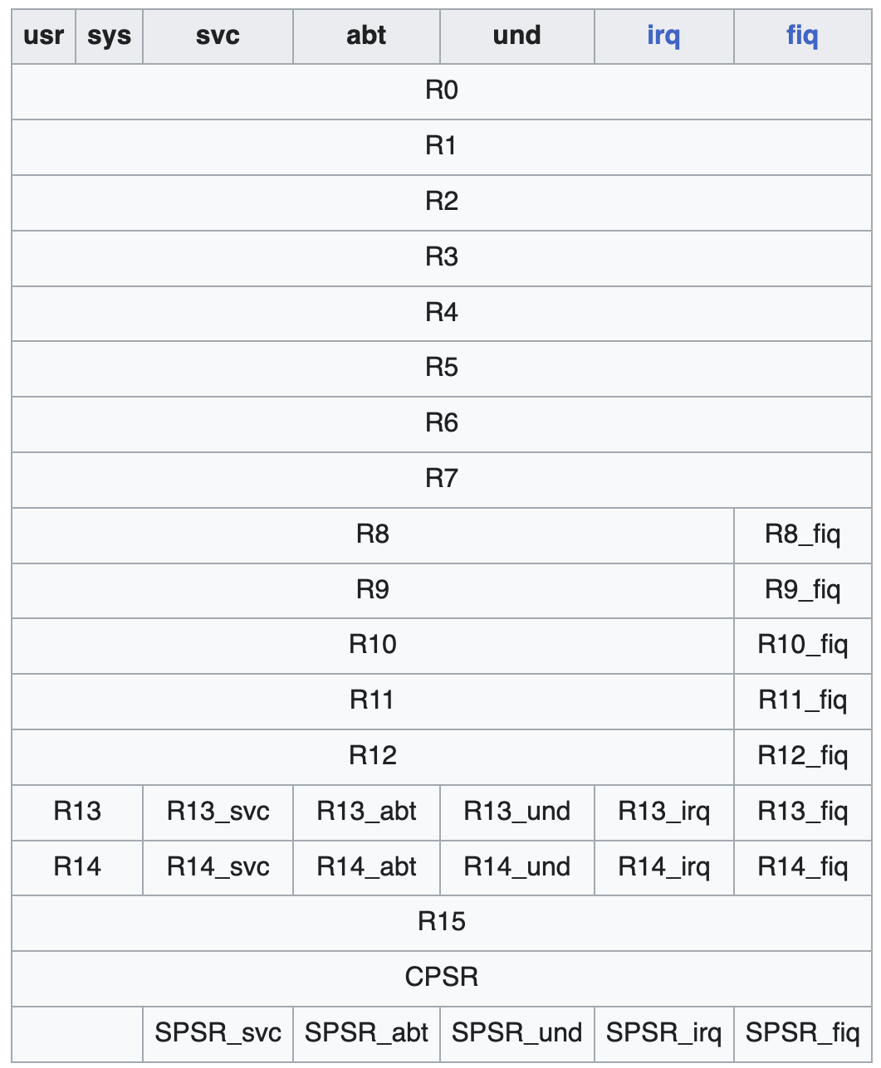
ARM Assembly
.global _start
_start:
MOV R0, #3 @ Load 3 into R0
MOV R1, #4 @ Load 4 into R1
ADD R0, R0, R1 @ R0 = R0 + R1 (3 + 4 = 7)
MOV R7, #1 @ syscall: exit
SWI 0 @ exit with code in R0 (7)

Slide 10
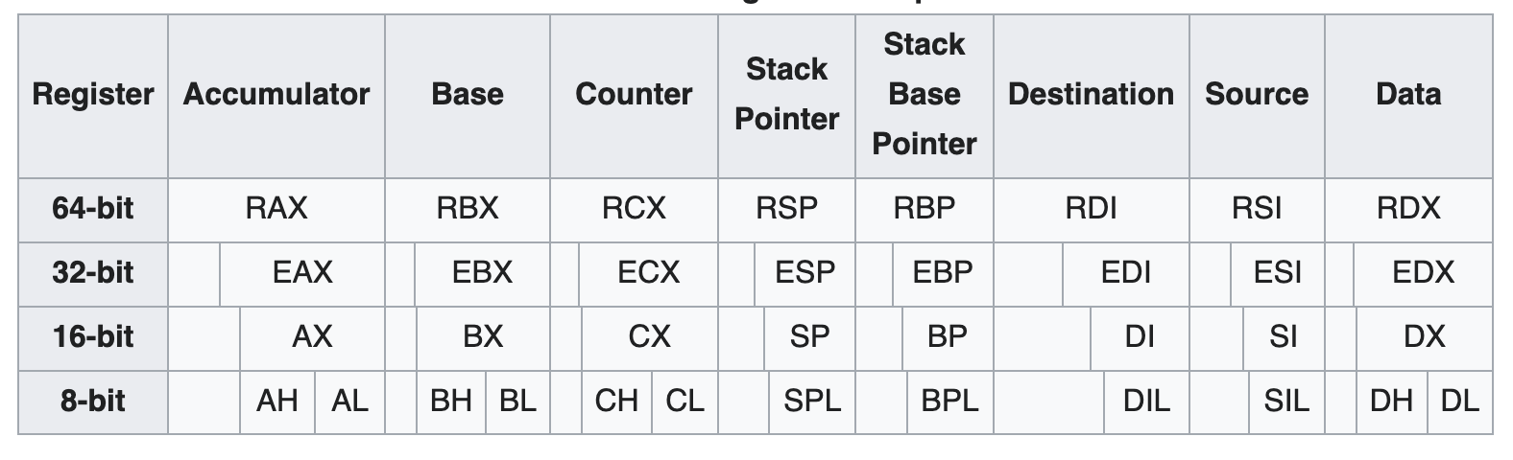
Intel X86 Assembly
global _start
_start:
mov eax, 3 ; Load 3 into eax
mov ebx, 4 ; Load 4 into ebx
add eax, ebx ; eax = eax + ebx (3 + 4 = 7)
mov ebx, eax ; exit code = sum (7)
mov eax, 1 ; syscall number for exit
int 0x80 ; make syscall

Slide 11
A Very Simple CPU
The CDC8512 is designed to be understandable

Slide 12
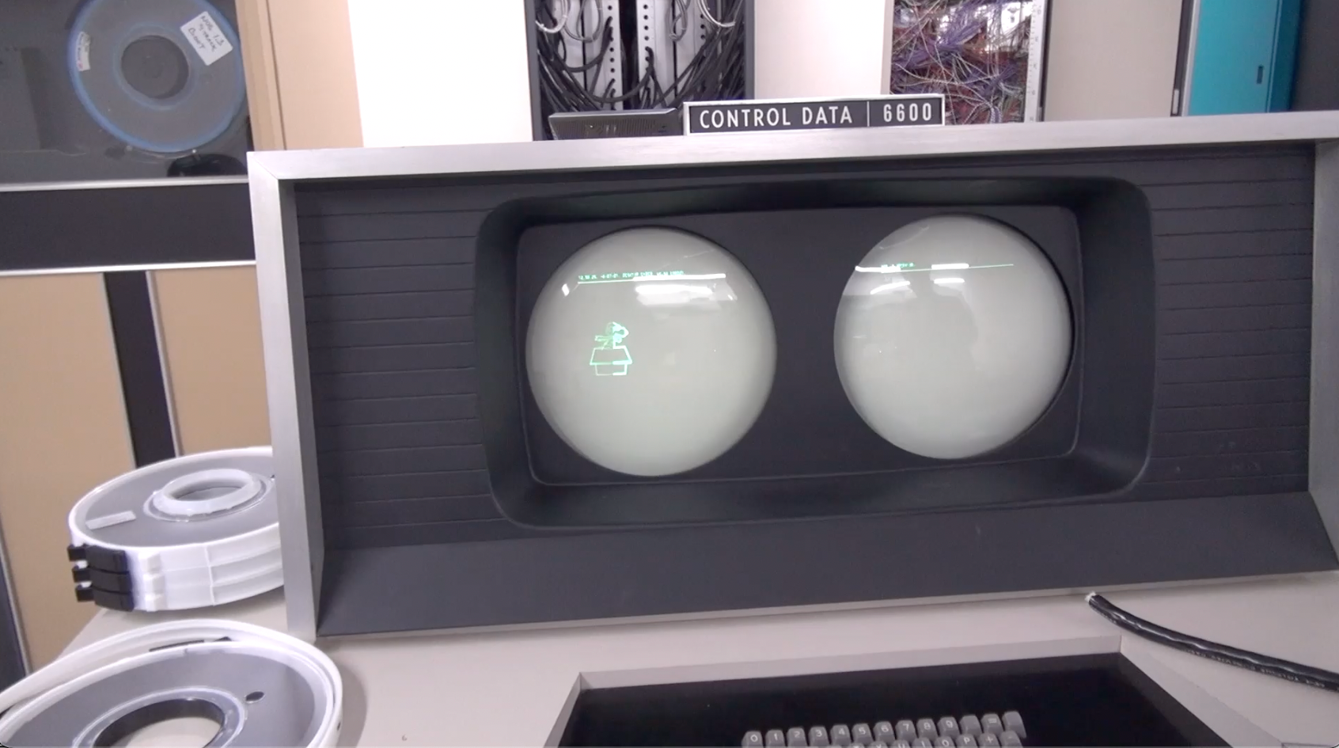
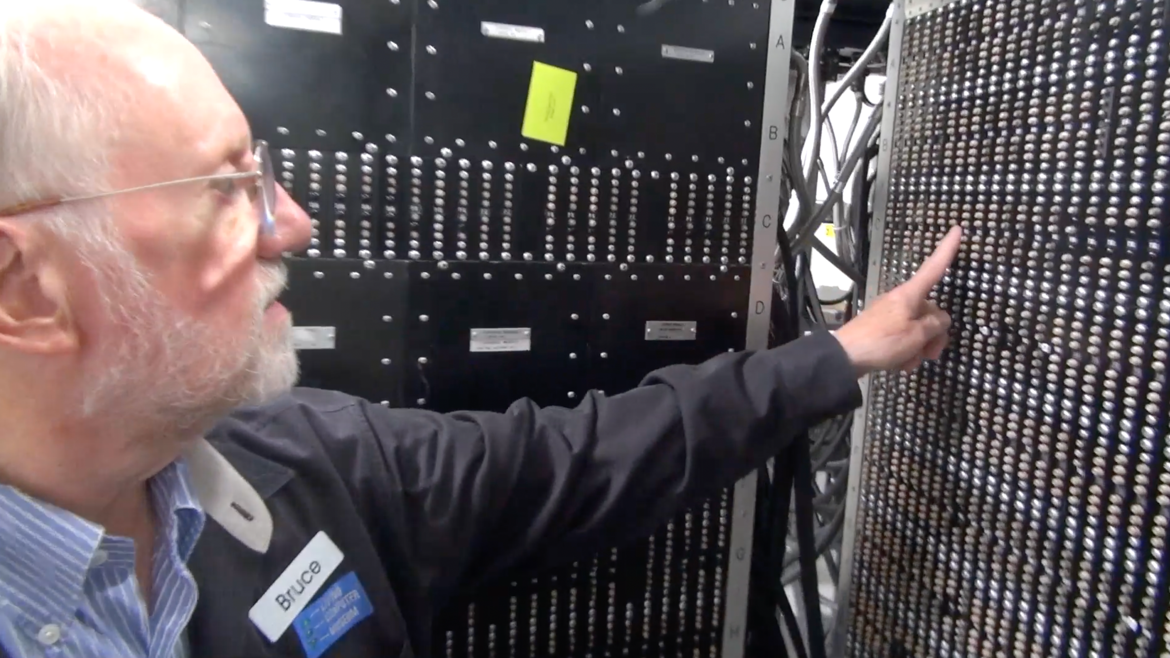
CDC 8512 - Inspired by CDC 6500
Control Data Corporation
Mid 1960’s – mid-1970’s
Dr. Chuck’s first computer
  FORTRAN
  Assembly Language
https://en.wikipedia.org/wiki/CDC_6000_series#Central_processor

Slide 13
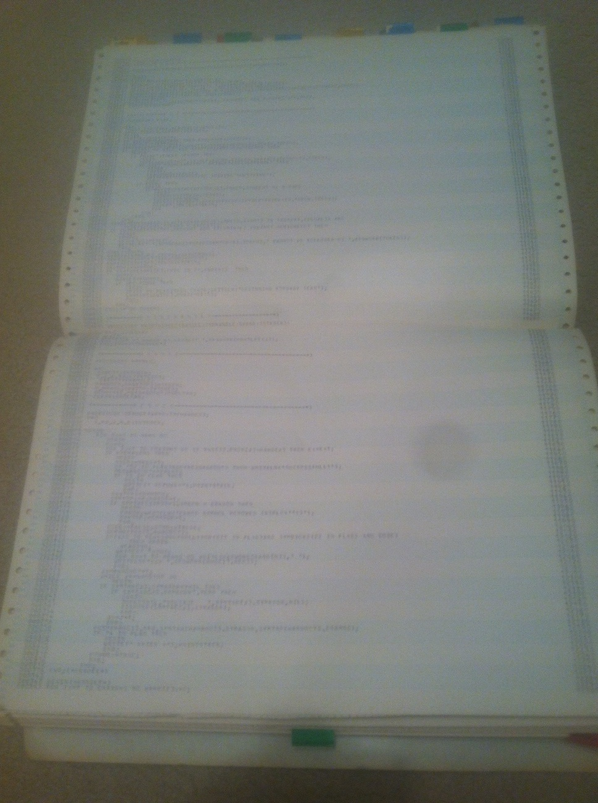
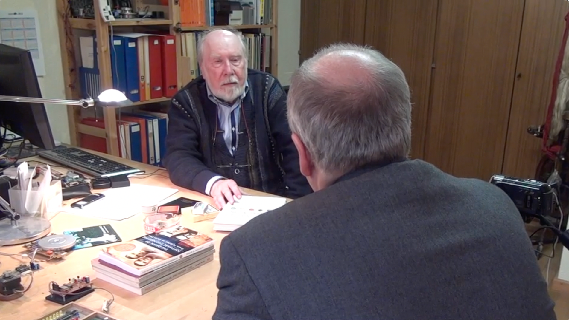
CDC 8512 - Inspired by CDC 6500
Control Data Corporation
Mid 1960’s – mid-1970’s
Dr. Chuck’s first computer
  FORTRAN
  Assembly Language
  Pascal
https://en.wikipedia.org/wiki/CDC_6000_series#Central_processor

Slide 14
About the CDC6500
60 bit words – Integer and floating point formats
6 bit characters - upper case only
Two kinds of data registers - A0-A7 – Address and X0-X7 Operands
To load from memory you put the address in A1-A5 and the data from memory is loaded into the corresponding X1-X5
To store into memory you put the data in X6 or X7 and Set the corresponding A6 or A7 to the location where you want the memory stored

Slide 15
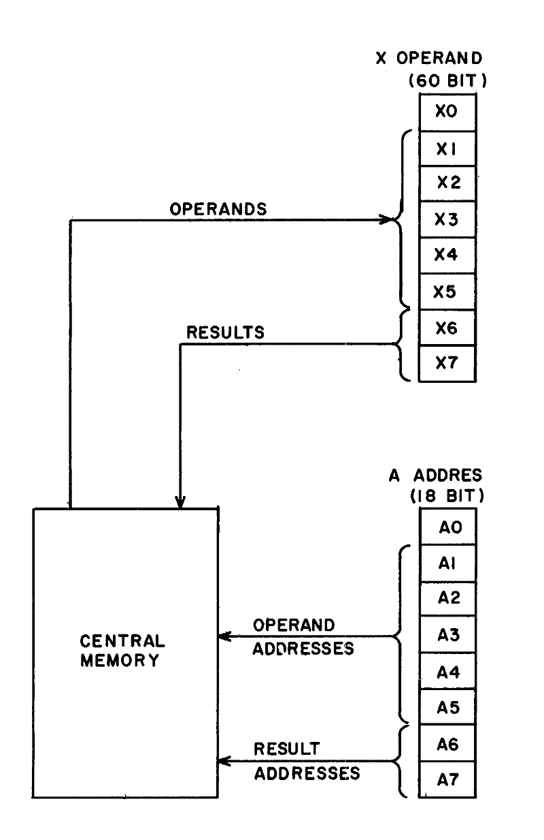
To provide a more compact symbolic language, the 24 operating registers are identified by letters and numbers:
A = Address Register (A0, A1 .. A7)
B = increment register (B0, B1 … B7)
X = operand register (X0, X1 … X7)
The operand registers hold operands and results for servicing the functional units. Five registers (X1-X5) hold read operands from Central Memory and two registers X6 – X7) hold results to be sent to Central Memory (Figure 3-2).
Operands and results transfer between memory and these registers as a result of placing a quantity into a corresponding address register (A1-A7).
-- Control Data 6400/6500/6660 Computer Systems Reference Manual
Figure 3.2
http://ygdes.com/CDC/60100000D_6600refMan_Feb67.pdf

Slide 16
About the CDC8512
8 bit words – Positive integers only (i.e. like a C char)
8 bit characters – ASCII (i.e. like a C char)
32 bytes of Instruction memory and 32 bytes of Data memory
Eight 8-bit registers (A0-A3) and (X0-X3)
When A0 is set it causes a load from Data[A0] into X0 to happen
When A1 is set it causes a load from Data[A1] into X1 to happen
When A2 is set it causes a store from X2 into Data[A2] to happen
When A3 is set it causes a store from X3 into Data[A3] to happen

Slide 17
CDC8512 Architecture
Central Processing Unit
Instruction Memory
Data Memory
PC
255
CM
<=>
0x00
255
0x00
255
A0
255
255
0x01
255
0x01
255
X0
Load
Registers
A1
255
X1
255
0x02
255
0x02
255
0x03
255
0x03
255
A2
255
X2
255
Store
Registers
0x04
255
0x04
255
A3
255
X3
255
0x05
255
0x05
255
…
…
0xFD
255
0xFD
255
0xFE
255
0xFE
255
0xFF
255
0xFF
255

Slide 18
CDC 8512 – Instruction Set
https://www.ca4e.com/cdc8512/documentation.html

Slide 19
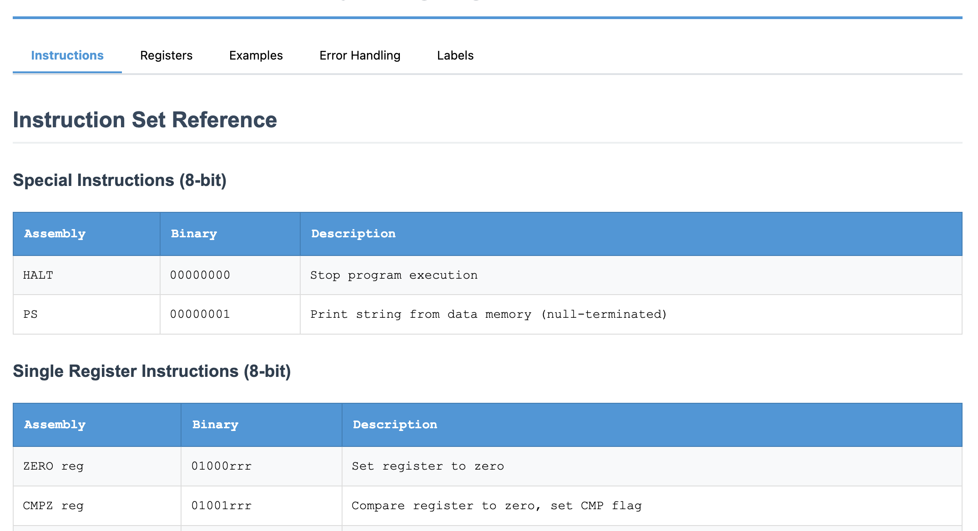
CDC8512 CPU Reference

Slide 20
Set a Register
SET X3, 'C' ; Set X3 to the value for ASCII C (67)
SET A3, 0 ; Set A3 to zero and store 'C' in data memory location 0x00
SET A1, 0 ; Set A1 to zero and load memory location 0x00 into X0
MOV X1, X3 ; Copy X3 to X1
SET A3, 0x01 ; Set A3 to 1 and store 'C' in data memory location 0x01
SET X3, 0x00 ; Set X3 to zero
SET A3, 0x02 ; Set A3 to 0x02 and store X3 into location 0x02
; Note constants can be decimal (0-255) hexadecimal (0x00-0xff) or a single
; ASCII character in single quotes 'a'

Slide 21
Register Arithmetic
; This will print: Hello
SET X3, 'H' ; Set X3 to the value for ASCII H
SET A3, 0 ; Set A3 to zero and store 'H' in data memory location 0x00
SET X3, 'e' ; Set X3 to 'e'
INC A3 ; Add 1 to A3 and store 'e' in location 0x01
SET X3, 'l' ; Set X3 to 'l'
ADD A3, 1 ; Add 1 to A3 and store 'l' in location 0x02
INC A3 ; Add 1 to A3 and store 'l' in location 0x03
ADD X3, 4 ; Add 4 to X3 so that it is now 'p'
DEC X3 ; Subtract 1 from X3 so that it is now 'o'
INC A3 ; Add 1 to A3 and store '0' in location 0x04
SET X3, 0 ; Set X3 to integer zero
INC A3 ; Add 1 to A3 and store integer 0 in location 0x05
PS ; Print memory starting at data address 0 as an
; ASCII string, stopping when a zero is encountered

Slide 22
Comparison and Jumps
JP 0x12 ; Set the PC (Program Counter) to an instruction address and
; continue execution at that address
CMP X3, 42 ; Compare a register to a constant and set comparison status
JE 0x12 ; Jump to the instruction address if comparison status is =
JG 0x12 ; Jump to the instruction address if comparison status is >
JL 0x12 ; Jump to the instruction address if comparison status is <

Slide 23
Miscellaneous Instructions
PS # Print data area starting at specified data address
# stopping when an integer 0 byte is encountered
HALT # Stop Execution

Slide 24
Summary
SX3 A3 # Copy a register to another
SX3 42 # Set a register to an 8-bit
INC A1 # Add 1 to a register
DEC X3 # Subtract 1 from a register
ADD X1, 42 # Add a constant to a register
SUB X3, 42 # Subtract a constant from a register
JP 0x12 # Jump to a label
CMP X3, 42 # Compare a register to a constant and set comparison status
JE 0x12 # Jump to the address if CMP was equal
JG 0x12 # Jump to the address if CMP was >
JL 0x12 # Jump to the address if CMP was <
PS # Print data area as character string
DI # Dump Instruction area in hex 16 per line
DD # Dump data area in hex 16 per
HALT # Stop Execution

Slide 25
CDC 8512 – Machine Language
(a.k.a. the zeros and ones of programming)

Slide 26
CDC 8512 - Assembly / Machine Code
SET X2, 'H'
ZERO A2
SET X2, 'i'
INC A2
PS
HALT
10000110
01001000 'H'
01000010
10000110
01101001 'i'
01010010
00000001
00000000

Slide 27
Single Register 8-bit Instruction
Zero Register
Register
ZERO A2
0
1
0
0
0
0
1
0
Op Code
Register
Number
0 = A register
1 = X register

Slide 28
Set Register to Constant (16-bit instruction)
Set Register
SET X2,'H'
1
0
0
0
0
1
1
0
0
1
0
0
1
0
0
0
Op Code
ASCII for 'H'
Register
Number
0 = A register
1 = X register

Slide 29
Single Register 8-Bit Instruction
INC A2 # Increment A2
Decrement Register
Register
0
1
0
1
0
0
1
0
Op Code
Register
Number
0 = A register
1 = X register

Slide 30
Print and Halt Instructions
0
0
0
0
0
0
0
1
PS # Print Memory
HALT # Stop the CPU
0
0
0
0
0
0
0
0

Slide 31
Two Register Instruction
Register
Copy
Destination
Register
Source
Register
MV A1,X3 ; Copy A1 to X3
1
1
0
0
1
1
1
1
0 = A register
1 = X register
Register
Number
Register
Number
0 = A register
1 = X register

Slide 32
CDC8512 Emulator in
JavaScript
// 5-bit patterns (bits 7-3)
else if ((instruction >> 3) === 0x08) { // 01000xxx - ZERO
const register = instruction & 0x07;
const regName = this.getRegisterName(register);
this.cpu[regName] = 0;
// CDC 6500 load/store architecture:
if (regName === 'a0') {
this.cpu.x0 = this.cpu.memory[this.cpu.a0];
} else if (regName === 'a1') {
this.cpu.x1 = this.cpu.memory[this.cpu.a1];
} else if (regName === 'a2') {
this.cpu.memory[this.cpu.a2] = this.cpu.x2;
} else if (regName === 'a3') {
this.cpu.memory[this.cpu.a3] = this.cpu.x3;
}
pcIncrement = 1;
}

Slide 33
Emulators for Fun

Slide 34
Building Emulators for Historical CPUs
It is not all that difficult to build an emulator for an older (simpler) CPU
Modern processors on our phones and computers are so fast that JavaScript in a browser can emulate historical machine code faster than the original hardware
The computer / phone / browser graphics are also far better
And it can be great fun

Slide 35
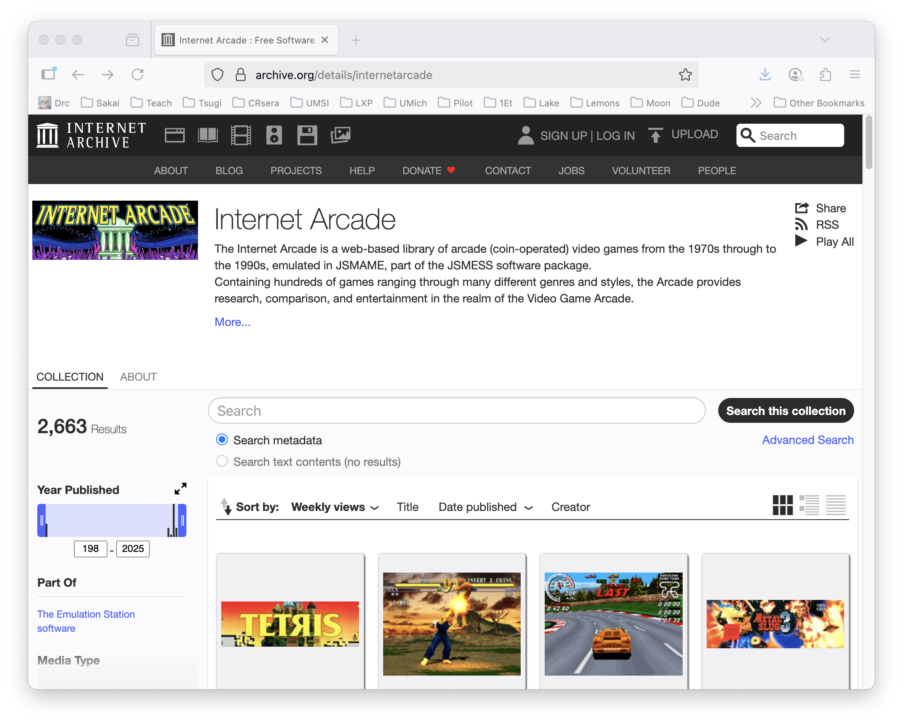
Archive.org: Internet Arcade

Slide 36
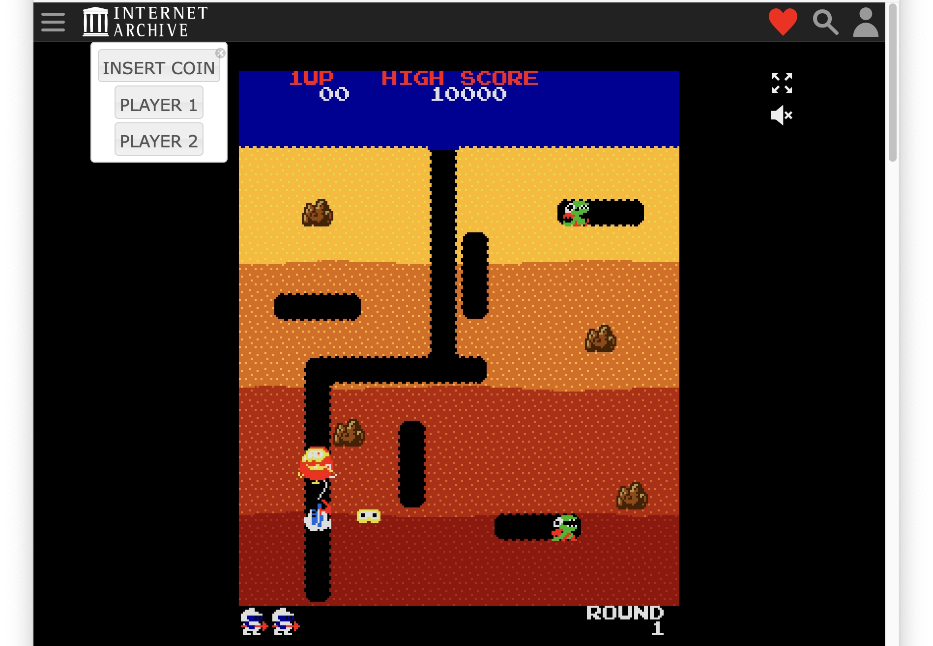
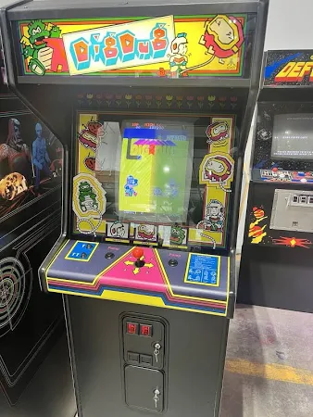
Game:
Dig Dug

Slide 37
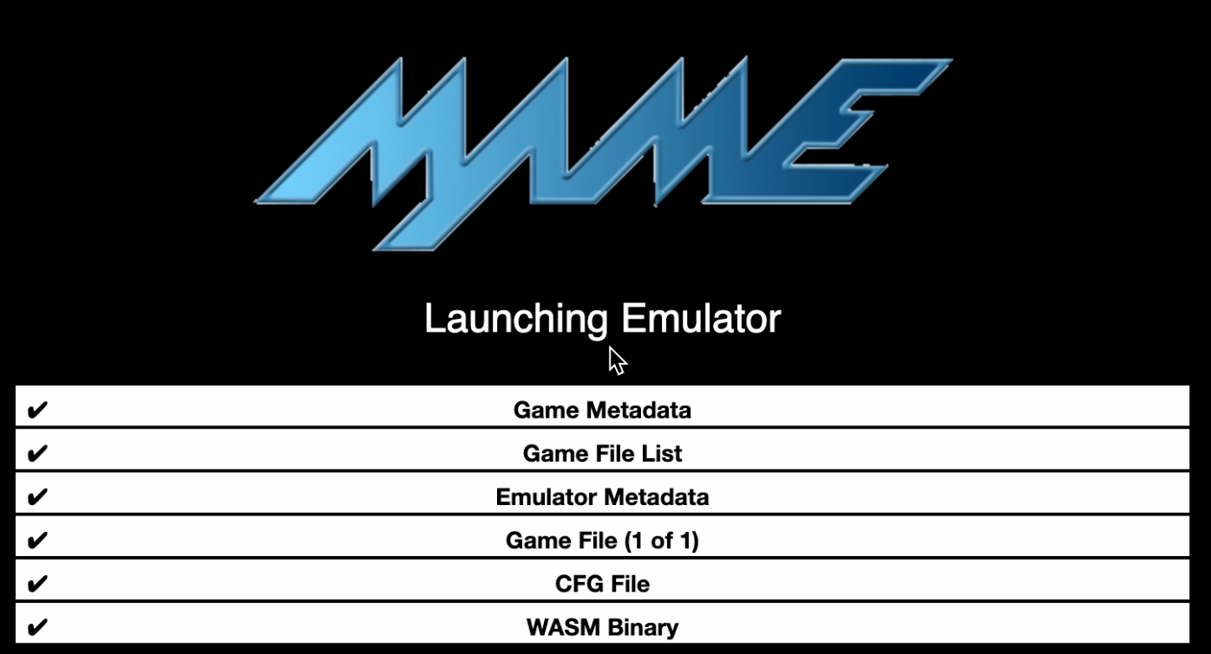
Dig Dug Startup – JSMAME Emulator

Slide 38
CPU Evolution
Why we invented our own super simple processor to learn.

Slide 39
Apple Computer Processors over time
MOS 6502 - Apple II – 1977 - 1993
Motorola MC68000 – Macintosh 1984-1994
IBM PowerPC – Macintosh 1994 – 2006
Intel x86 – Macintosh (2006-2020)
Samsung ARM – iPhone (2007-2009)
Apple ARM – iPhone (2010-Present)
Apple ARM – Macintosh (2020-Present)
Apple currently redesigns their CPUs based on workload over time – Image Processing / Audio / Video / Gaming / Artificial Intelligence

Slide 40
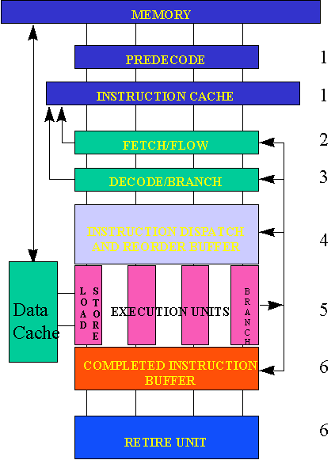
Reading:
Post-Risc
Architecture
https://cse.msu.edu/~enbody/postrisc/postrisc2.htm

Slide 41
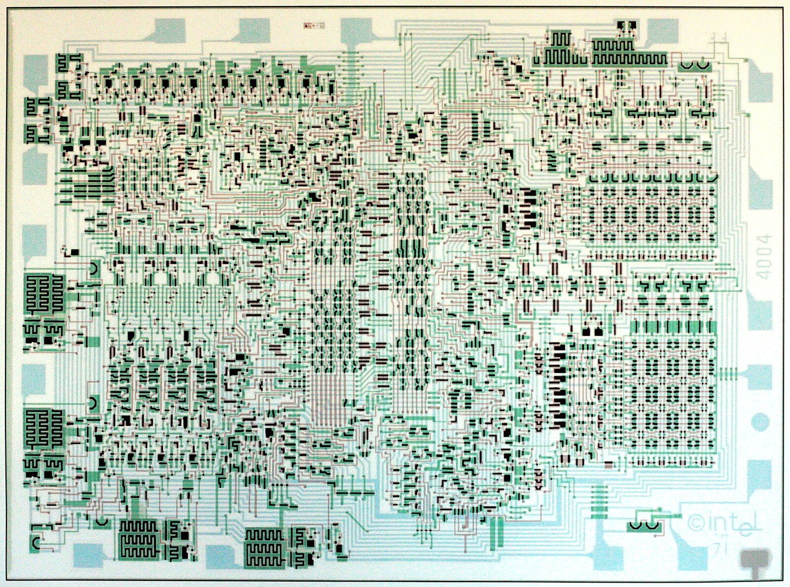
Reading:
Intel 4004
https://www.4004.com/
http://e4004.szyc.org/
http://e4004.szyc.org/iset.html
http://e4004.szyc.org/emu/

Slide 42
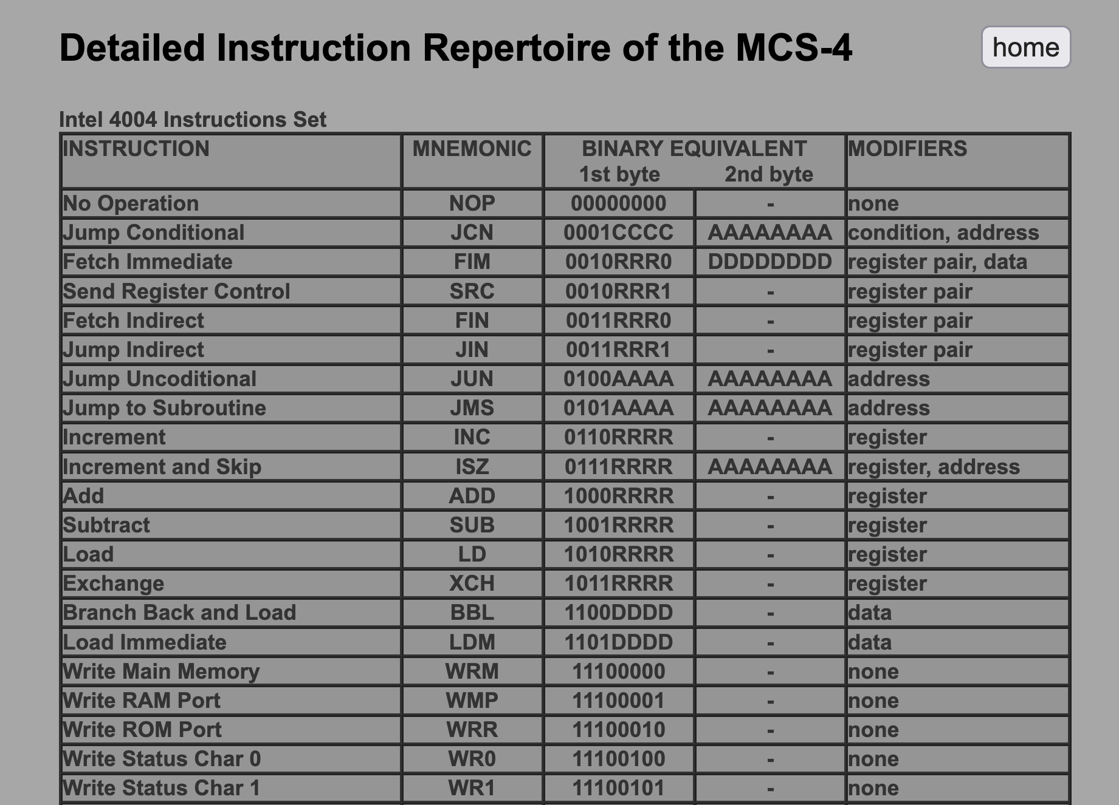
http://e4004.szyc.org/iset.html

Slide 43
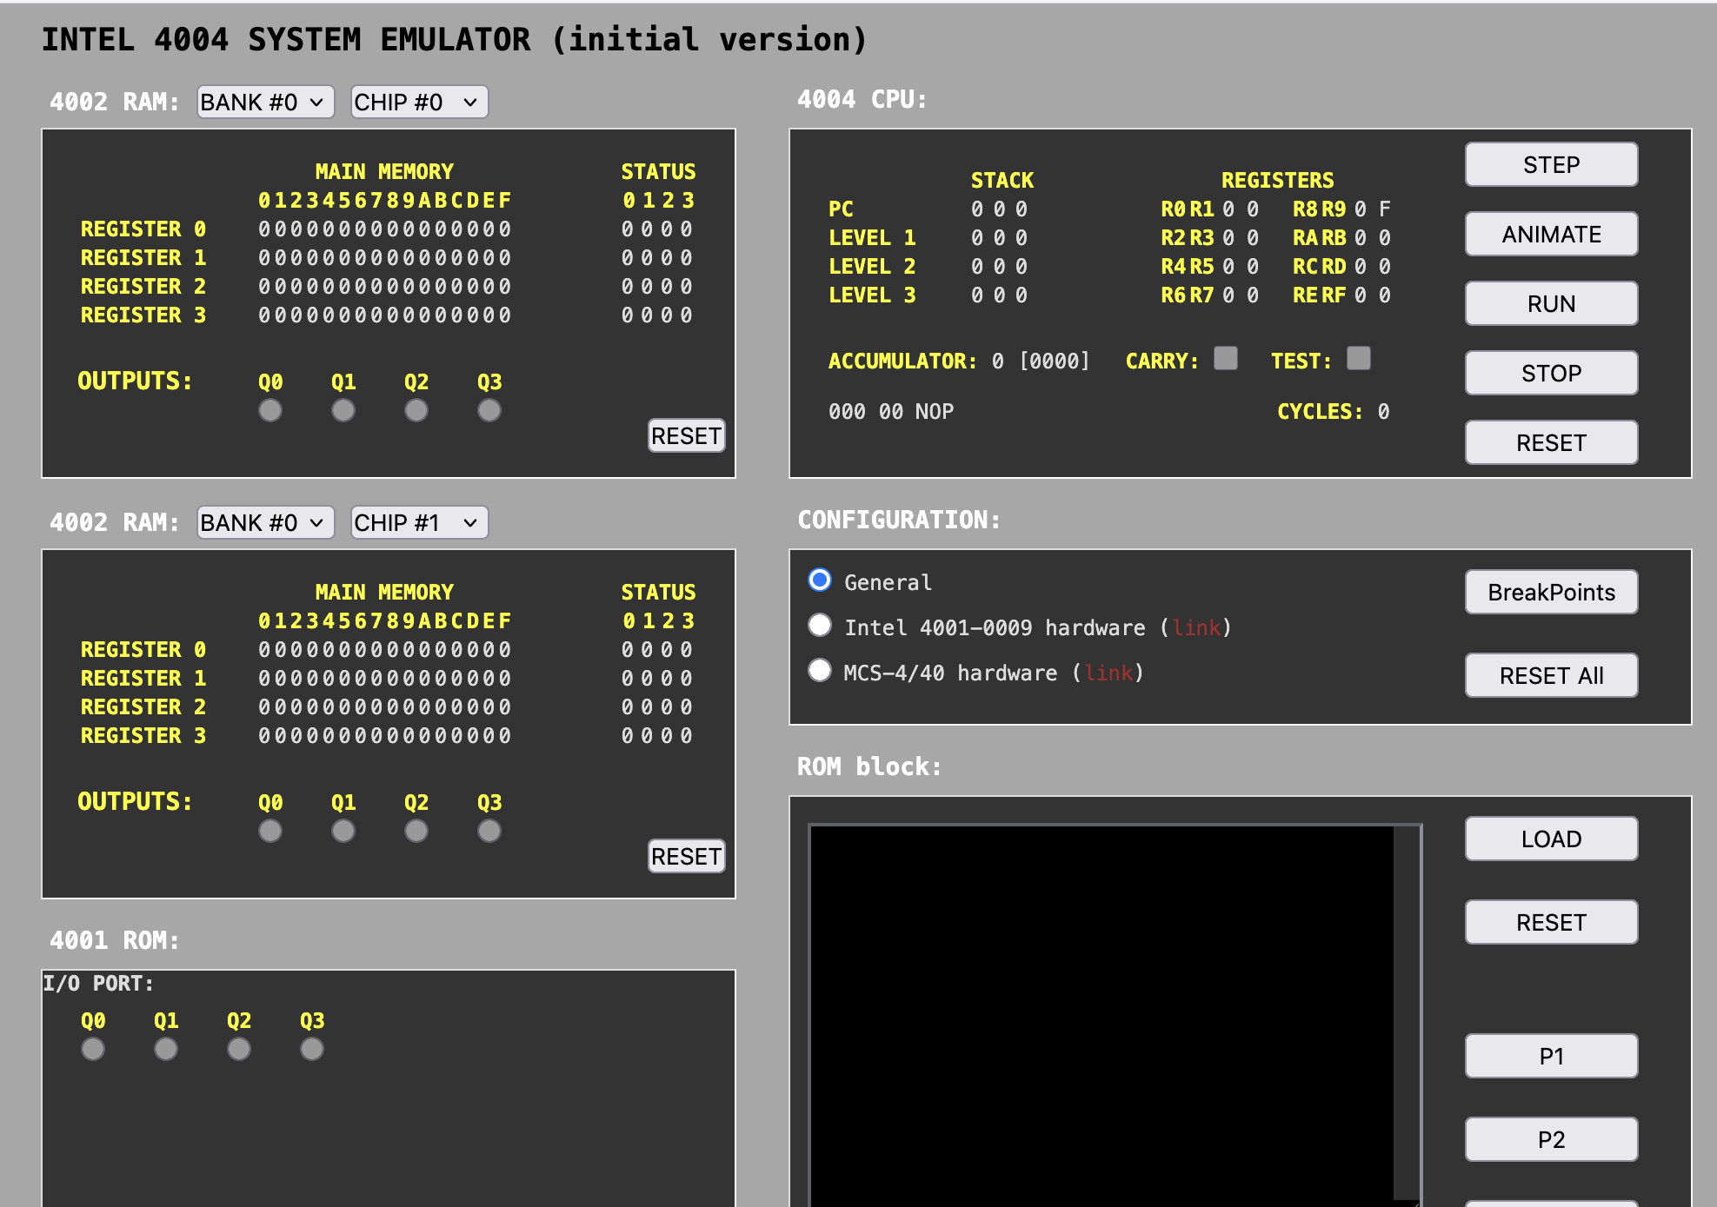
http://e4004.szyc.org/emu/

Slide 44
WASM – Web Assembly
There is a machine language emulator built into browsers called Web Assembly
For a wide range of software, compiling to WASM and running in JavaScript is enough
WASM is a different syntax than most Assembly languages – but it still compiles to a binary-machine code
C Programming for Everybody (www.cc4e.com) C Playground compiles C to WASM and then runs the WASM in the user's browser

Slide 45
WASM Hello World
;; Hello World WASM Example
(module
(import "console" "log" (func $log (param i32 i32)))
(memory 1)
(data (i32.const 0) "Hello, World!")
(func $main (result i32)
(call $log (i32.const 0) (i32.const 13))
(i32.const 42)
)
(export "main" (func $main))
)
00000000: 00 61 73 6d 01 00 00 00 01 0a 02 60 02 7f 7f 00 |.asm.......`....|
00000010: 60 00 01 7f 02 0f 01 07 63 6f 6e 73 6f 6c 65 03 |`.......console.|
00000020: 6c 6f 67 00 00 03 02 01 01 05 03 01 00 01 07 11 |log.............|
00000030: 02 06 6d 65 6d 6f 72 79 02 00 04 6d 61 69 6e 00 |..memory...main.|
00000040: 01 0a 0c 01 0a 00 41 00 41 0d 10 00 41 2a 0b 0b |......A.A...A*..|
00000050: 13 01 00 41 00 0b 0d 48 65 6c 6c 6f 2c 20 57 6f |...A...Hello, Wo|
00000060: 72 6c 64 21 |rld!|

Slide 46
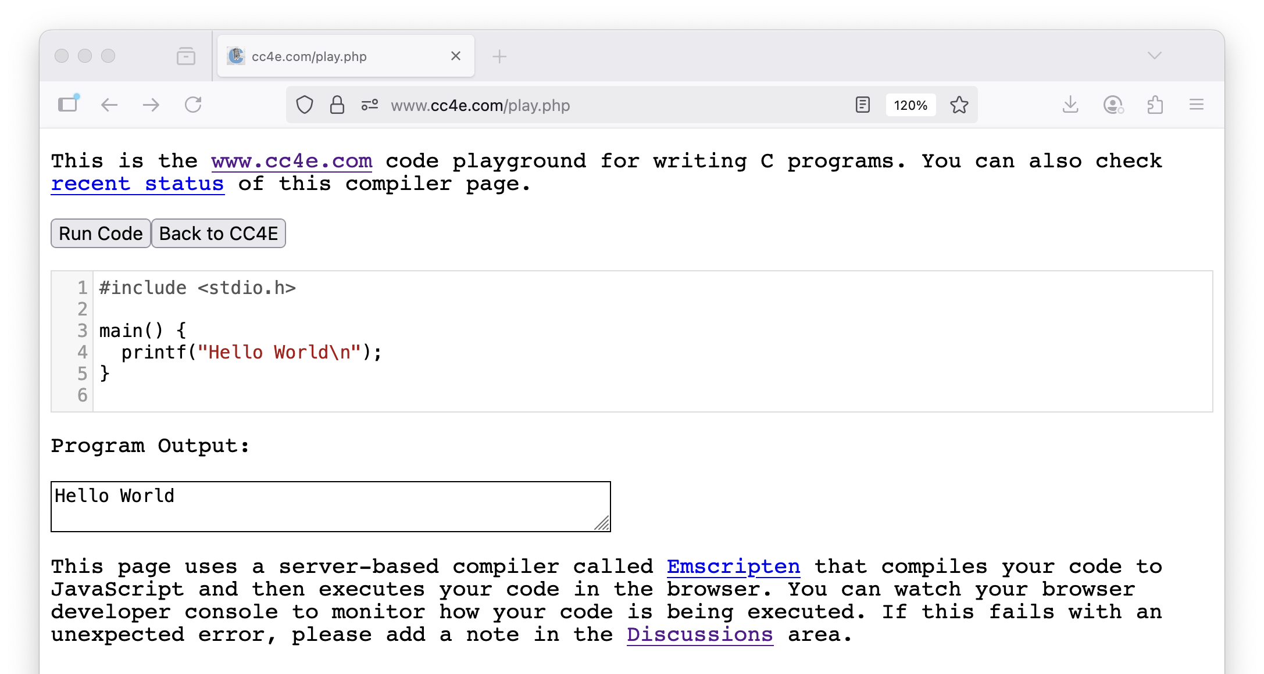

Slide 47
Summary
Fetch-Decode-Execute (a.k.a. Fetch-Execute-Cycle)
Look at the Intel x86 and ARM processor families
Explored the CDC8512 architecture, instruction set, assembly and machine languages
Explored an increasing use of in-browser emulators for games and other applications
Looked at CPU Evolution over time
Looked back at the Intel 4004
Looked forward at Web Assembly (WASM)

Slide 48
Acknowledgements / Contributions
These slides are Copyright 2025- Charles R. Severance (online.dr-chuck.com) as part of www.ca4e.com and made available under a Creative Commons Attribution 4.0 License. Please maintain this last slide in all copies of the document to comply with the attribution requirements of the license. If you make a change, feel free to add your name and organization to the list of contributors on this page as you republish the materials.
Initial Development: Charles Severance, University of Michigan School of Information
Insert new Contributors and Translators here including names and dates
Continue new Contributors and Translators here

